Slide 1
Debating the training of future measurement professionals
Educators of Measure SIGIMIE Session
Brian C. Leventhal, James Madison University, Chair/Moderator
Joseph A. Rios , University of Minnesota, Co-Chair
Corinne Huggins-Manley, University of Florida, Co-Chair
Allison Ames Boykin, University of Arkansas, Co-Chair
Notes:
A significant percentage of NCME membership reside as educators of educational measurement, psychological measurement, or related domains. In addition to performing research, these professionals are responsible for training future educational measurement professionals. Through recruiting students, teaching courses, and advising students, educators must develop the future professionals who will shape the field. In addition, internship mentors have a similar task of transforming future educational measurement professionals from students into practicing professionals. This SIGIMIE emphasizes scholarship and discussion of issues that these professionals currently face. The SIGIMIE focuses on: (1) Recruitment, (2) Teaching and Learning, and (3) Advising and Mentorship.

Slide 2
Educational Measurement Teaching Repository
Phase 1: syllabi, reading lists, and links to publicly available measurement-related data sets.
Begin collection Summer 2021
Build/post repository early 2022
Phase 2 : General expansion of artifact types in the EoM Repository (e.g., lecture materials, assignments).
TBD
Notes:
The Educators of Measurement SIGIMIE Repository (EoM Repository) will offer:
a dynamic, community-contributed, online collection of artifacts related to educating measurement students, interns, and recent graduates.
provide a formal structure for sharing helpful materials across an international community of educators of measurement.
foster a robust dialogue around teaching, mentoring, and advising students entering the field of educational measurement.
E-mail shortly after annual meeting
In-take form: https://form.jotform.com/211232766080146
We will seek information such as your name, e-mail, course artifact is for, etc. in order for users of the repository to give suitable reference. We will also include the set of guidelines for contributing and using the repository.

Slide 3
Debating the training of future measurement professionals
1. What are the substantive/technical skills measurement professionals would like emphasized in graduate training programs?
2. What are the soft skills measurement professionals would like emphasized in graduate training programs?
Notes:
Measurement professionals are employed in a variety of occupational settings, including higher education, K-12 districts, state governments, testing companies, non-profits, and program evaluation consortia. These professionals receive training across many different domains, such as educational research, evaluation, measurement, quantitative methods, psychometrics, educational psychology, assessment practice, and statistics (Pakman, Camara, & Huff, 2010). With varied job types and an immense breadth of training domains, defining educational measurement has proven to be a challenge (Bolt et. al, 2020). Regardless of whether a universal definition is a cause or artifact, debate and discussion around graduate training in educational measurement persists. This debate is illustrated in two recent curricula reviews across as many as 135 graduate programs, which showed inconsistencies regarding the measurement, statistics, psychology, and professional development training offered by programs in the U.S. (Randall et al., 2020; Russell et al., 2019). Although these reviews provide useful information, they have lacked extensive input from a wide-range of professionals in the field. Such input could generate discussion among faculty about potential curricula modifications, given faculty areas of expertise, the number of required institutional credits, and required student prerequisite knowledge.

Slide 4
Survey Development
Development of the Survey
Topics Selection
Question Type
For the following skills, what level of expertise do you expect students to graduate from a PHD program with?
Technical skills: None, Fundamental Awareness, Novice, Intermediate, Advanced, or Expert
Soft skills: Fundamental Awareness, Novice, Intermediate, Advanced, or Expert
Notes:
In addition to core competencies, which additional topics would you want a graduate student to study?
Select 10 of the following or alternatively:
How much time do you anticipate students would have experienced the following?
A full semester course
A half-semester course
A three-hour class period
A 1-hour seminar
An optional workshop
What level do you expect students to graduate with the following skills?
Expert;
Advanced;
Intermediate;
Novice;
Fundamental Awareness

Slide 5
Survey
Copy of survey located under Files for the session
Core Competencies:
ANOVA
Regression
Classical test theory
Item response theory
Multivariate statistics (MANOVA, discriminate analysis, etc.)
Validity
Test Development
Six Sections
Statistics; Measurement; Policy and Assessment; Education and Psychology; Other Topics; Soft Skills
Notes:
we considered core competencies of a doctoral
educational/psychological measurement program.
We considered these to be taught, or obtained through master’s level
coursework, in most programs:
Statistics had topics such as:
Bayesian statistics
Categorical data analysis (e.g.,
ROC)
Factor analysis and structural
equation modeling
General linear model
Growth modeling
Hierarchical linear modeling
Nonparametric statistics
Statistics consulting

Slide 6
Panel
Deborah Bandalos, James Madison University
Peggy Jones, Pasco County (FL) Dist School
Kavita Mittapalli, MN Associates, Inc.
Jonathan Rubright, National Board of Medical Examiners
Vince Verges, Florida Department of Education
Notes:
we have identified representatives from major employment settings to debate about what should be covered in measurement graduate programs through traditional courses and other learning experiences. The five employer types include: (a) the testing industry; (b) higher education institutions; (c) program evaluation consortia; (d) district; and (e) state education programs.
Deborah Bandalos has held academic positions at the University of Nebraska and the University of Georgia before accepting her current position as Professor and Director of the Assessment and Measurement Doctoral Program at James Madison University. Dr. Bandalos is the author of the book Measurement Theory and Applications for the Social Sciences and has served as associate editor of Multivariate Behavioral Research and Structural Equation Modeling. She is past president of the Society for Multivariate Experimental Psychology and the President-elect of the American Psychological Association's Division 5. Other current professional service activities include service on the Committee for Psychological Testing and Assessing of the American Psychological Association and on the Examination Committee of the Examination for Professional Practice in Psychology.
Peggy Jones is the director of the Office for Accountability, Research, and Measurement with Pasco County Schools. She has experience teaching at the elementary and middle school levels as well as the graduate level. She has worked as both a school-based and district-based administrator in a school district of approximately 75, 000 students in central Florida. She enjoys helping others to see the potential and the strength in using data to answer questions and accomplish goals.
Kavita Mittapalli is the CEO and founder of MNAssociates, Inc., a small research and evaluation consulting firm that she founded in 2004. Dr Mittapalli leads a team of five evaluators including a statistician to conduct small, medium, and large scale evaluations for various state and federal agencies including the NSF, US Departments of Defense, Education and Labor, NASA, and private foundations across the nation. Dr Mittapalli began her educational career in agricultural sciences from India, she then completed a masters in applied sociology and a PhD in research design and methodology both from George Mason University in Fairfax, VA. To date, MNA has completed 290 technical reports for its clients.
I look forward to our panel in one week. As I prep your introduction, I wanted to confirm that the following description is still accurate:
Jonathan D. Rubright serves as Vice President of the Office of Research at the National Board of Medical Examiners where he aligns research investments with organizational strategy, leads the NBME research team, manages the psychometric internship program, and contributes collaborative thought partnership to strategic challenges. With almost a decade of experience in the testing industry, John has consistently exceled in leading and managing operational, research, and developmental initiatives. His research interests are cross-disciplinary and include notable contributions in psychometrics, medicine, and medical education.
Vince Verges has overall responsibility for Florida’s K-12 statewide summative assessment system, as well as the Florida Teacher Certification Examination and the Florida Educational Leadership Exam. He has been in this position since 2013, has been with the Florida Department of Education for a total of fifteen years, and has been involved in developing Florida’s assessments since 1999. Prior to coming to the Department, Vince served for ten years in Florida’s public schools and colleges as an elementary school assistant principal, high school mathematics teacher, and college adjunct mathematics instructor.

Slide 7
Results
No panelist expects students to be an expert on any topic
However, some panelists expect students to be experts on soft skills
Different expectations of PhDs upon graduation among the panelists in different employment settings of measurement professionals.
Many topics had general consensus
Results organized by “Full Consensus”, Majority at each level, “Split”

Slide 8
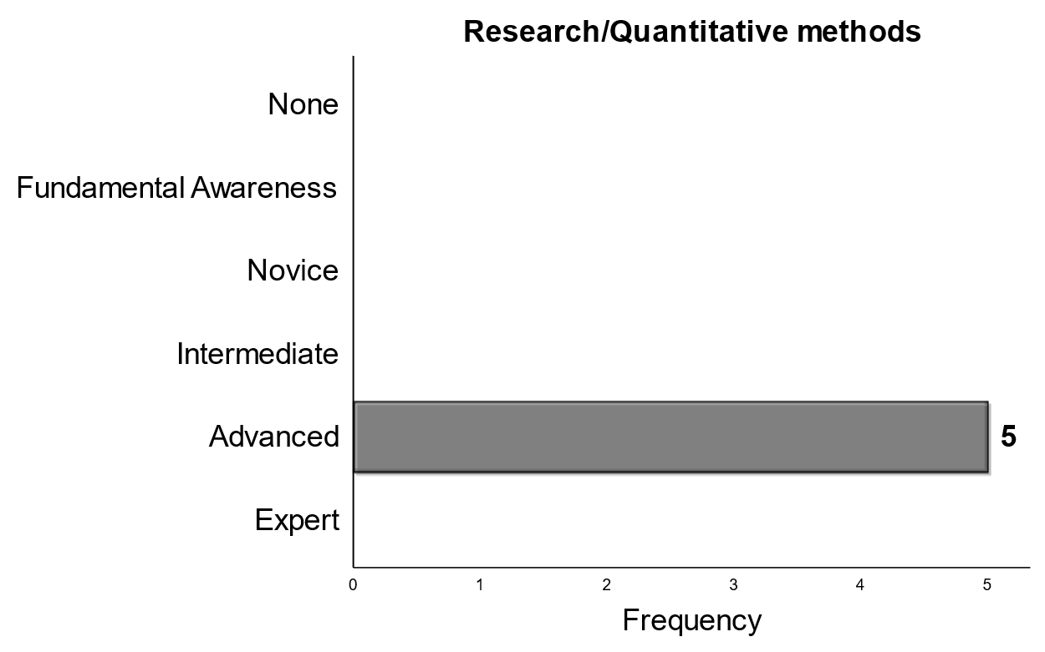
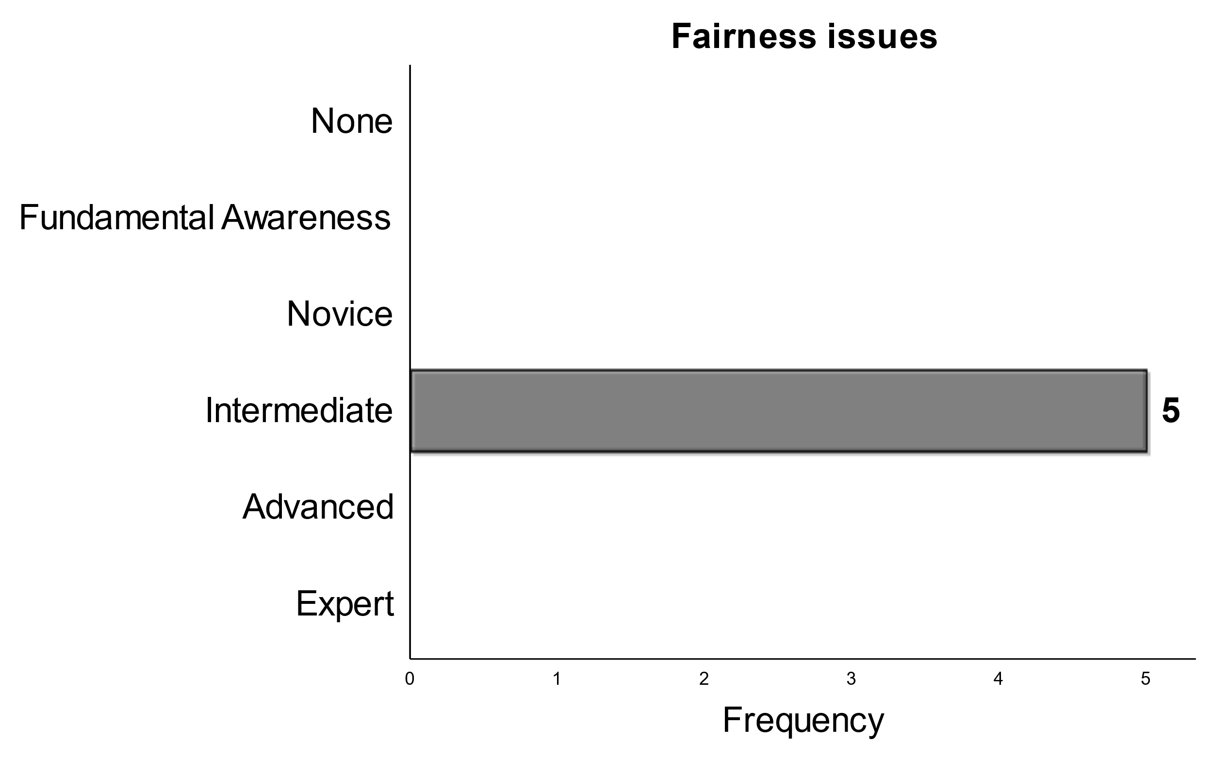
Consensus
Notes:
There were two topics that had full consensus. Those were research/quantitative methods and fairness issue. I think it is unsurprising the level of skill expected for graduating PhdS to perform research/quantitative methods

Slide 9
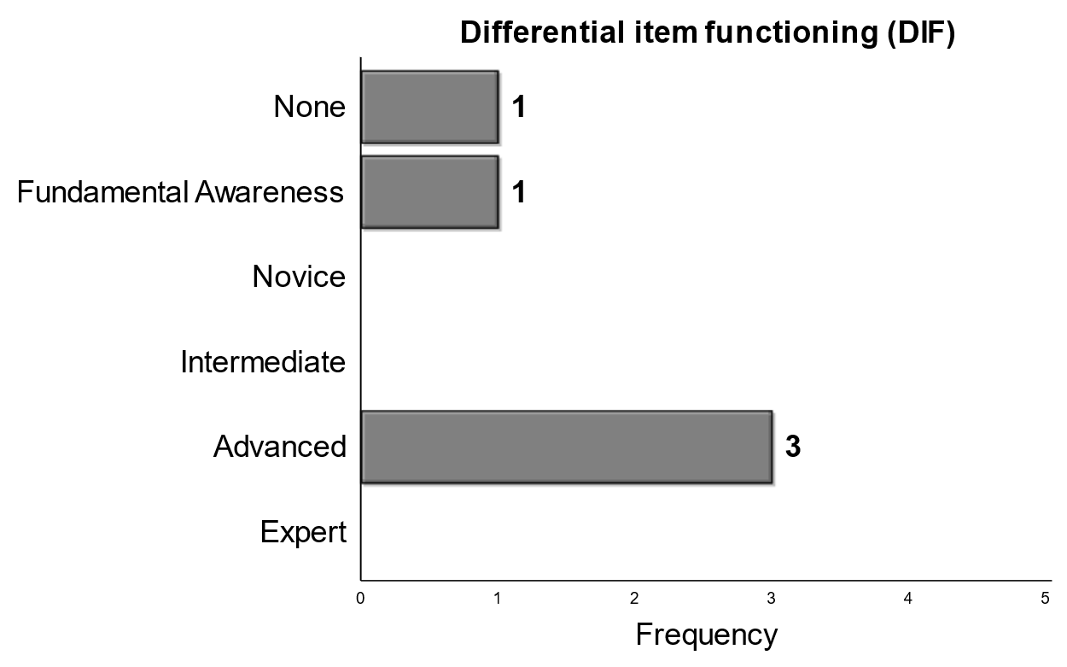
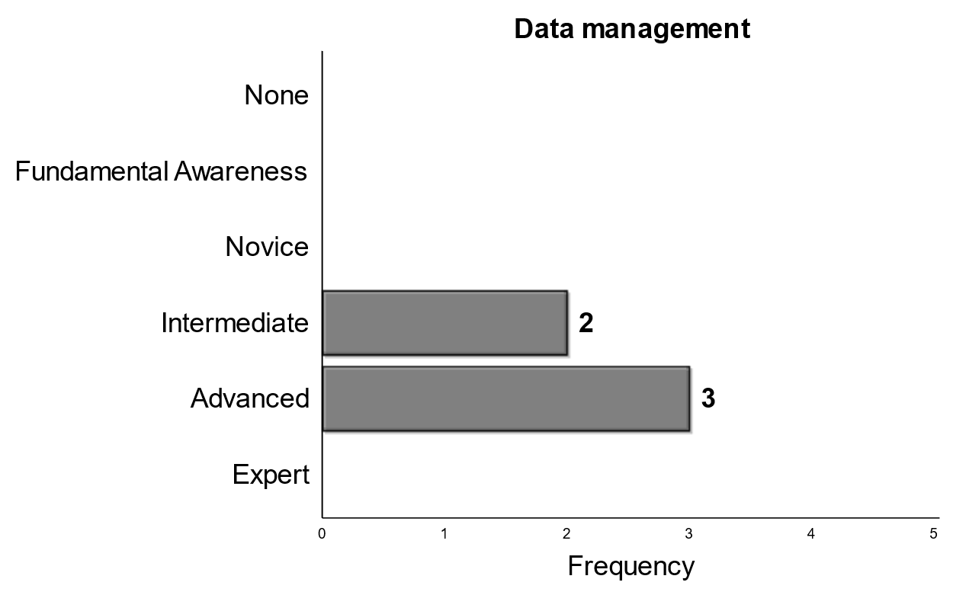
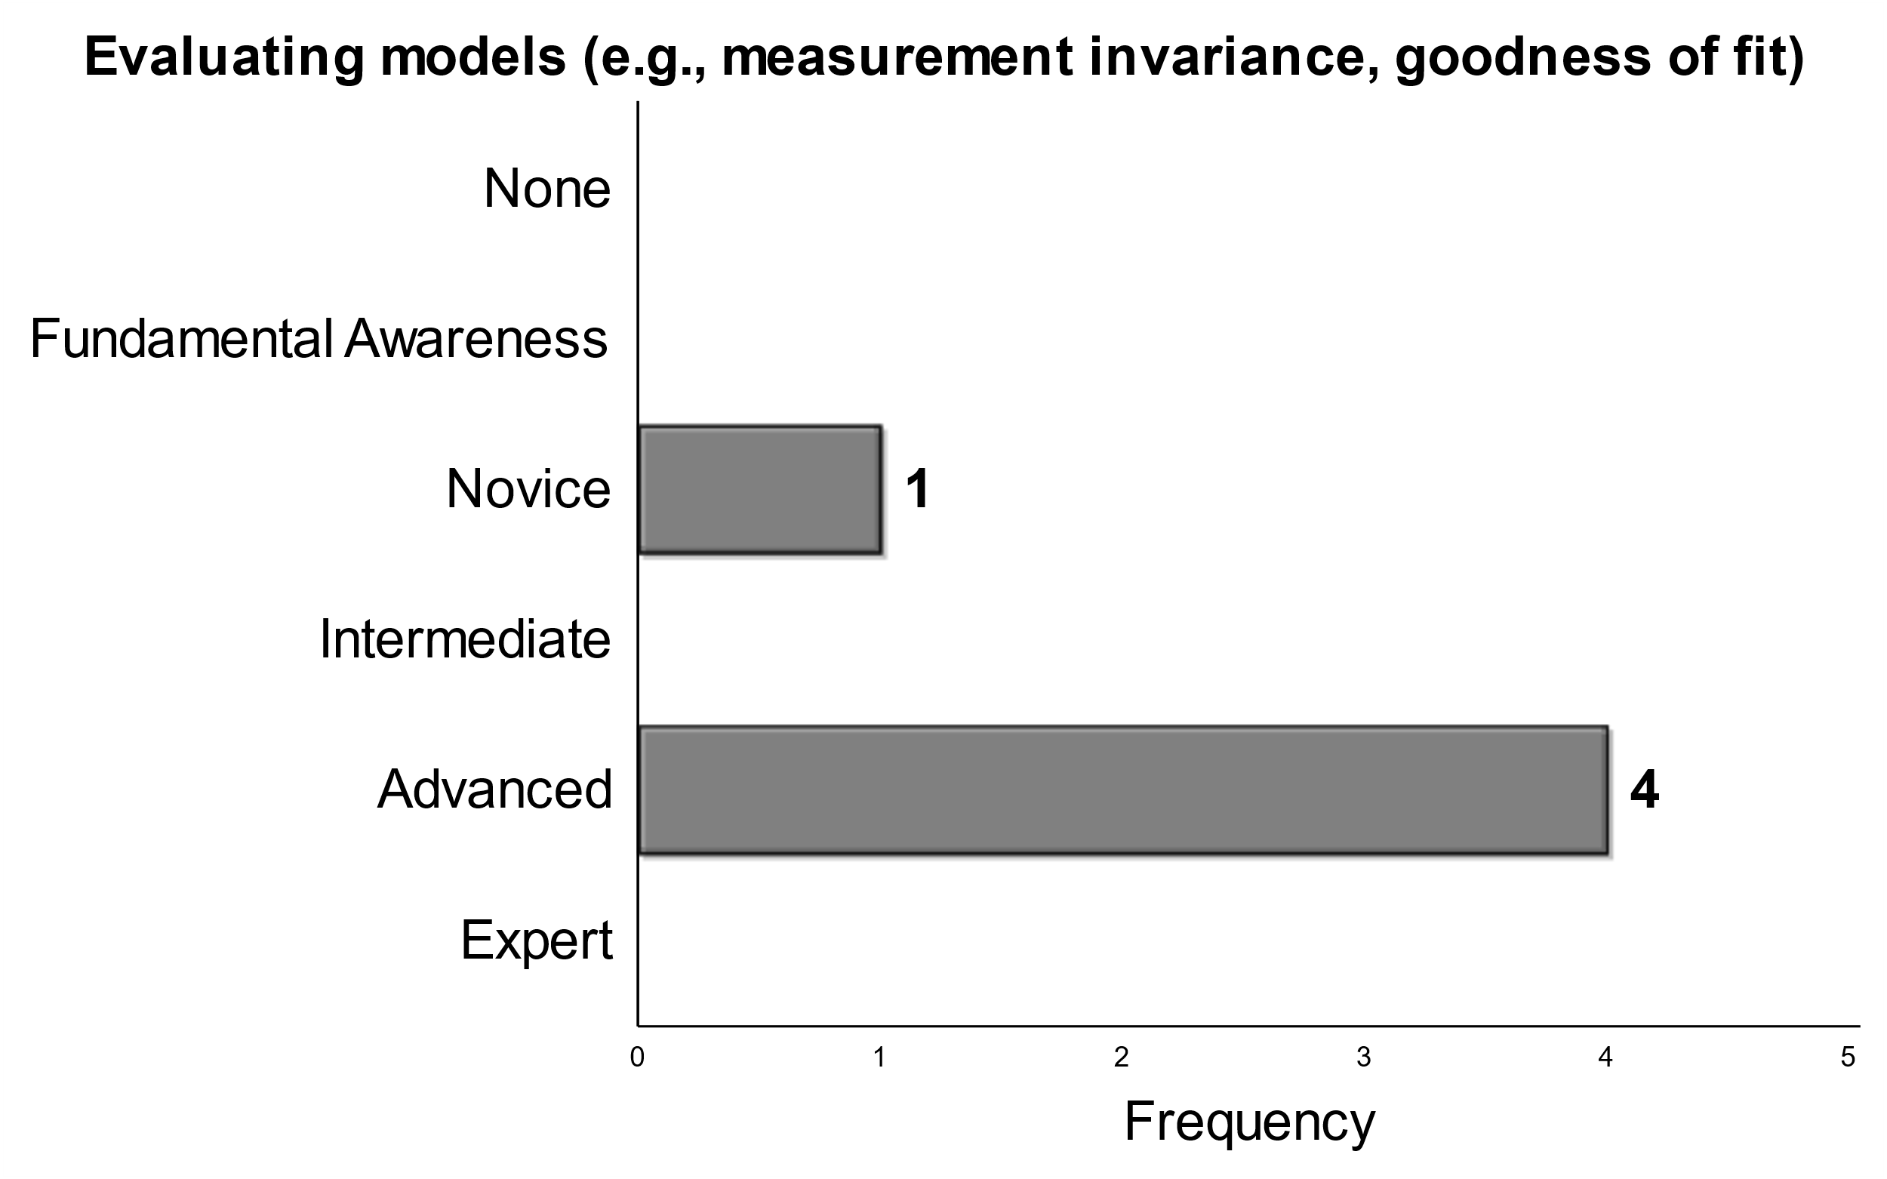
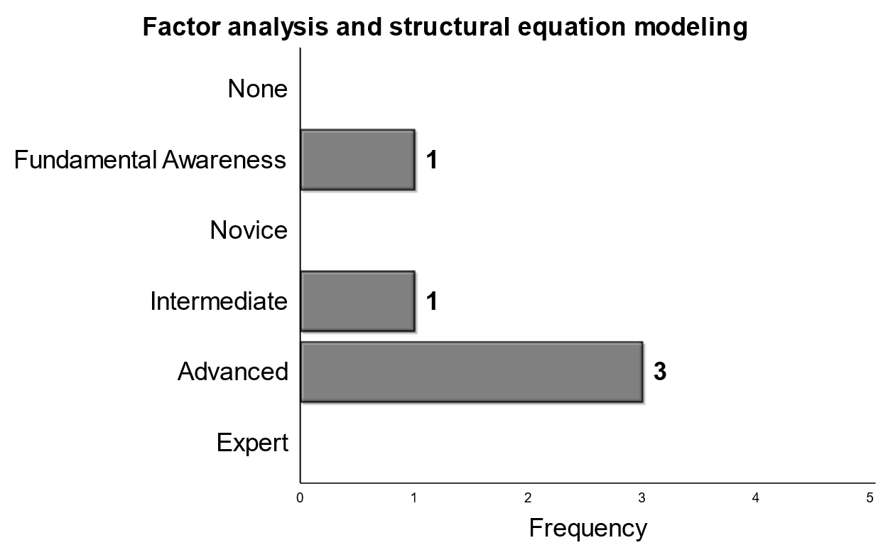
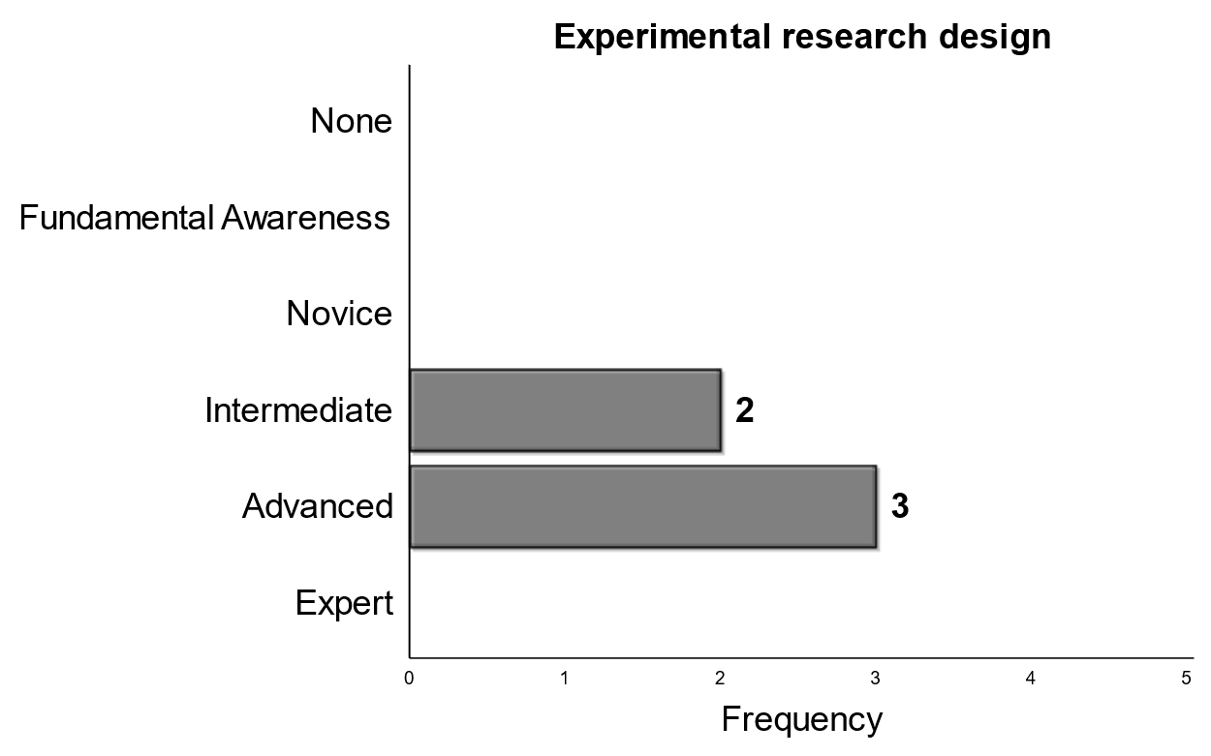
Majority - Advanced
Higher Mean
Notes:
Included here are items in which a majority of panelists selected an advanced as the level of expertise expected of graduating Phds. The items are then ordered from left to right by mean score with higher mean on the right side of your screen. The ability to evaluate models was nearly unanimous, however one panelists only expected a novice skill level. Data management and experimental design were both ranked quite high with majority picking advanced and the other two panelist selecting intermediate. Finally, we see that a majority of panelists expected PhDs to graduate with an advanced skill of DIF and Factor Analysis/structural equation modeling, but the either one or two rated each much lower.

Slide 10
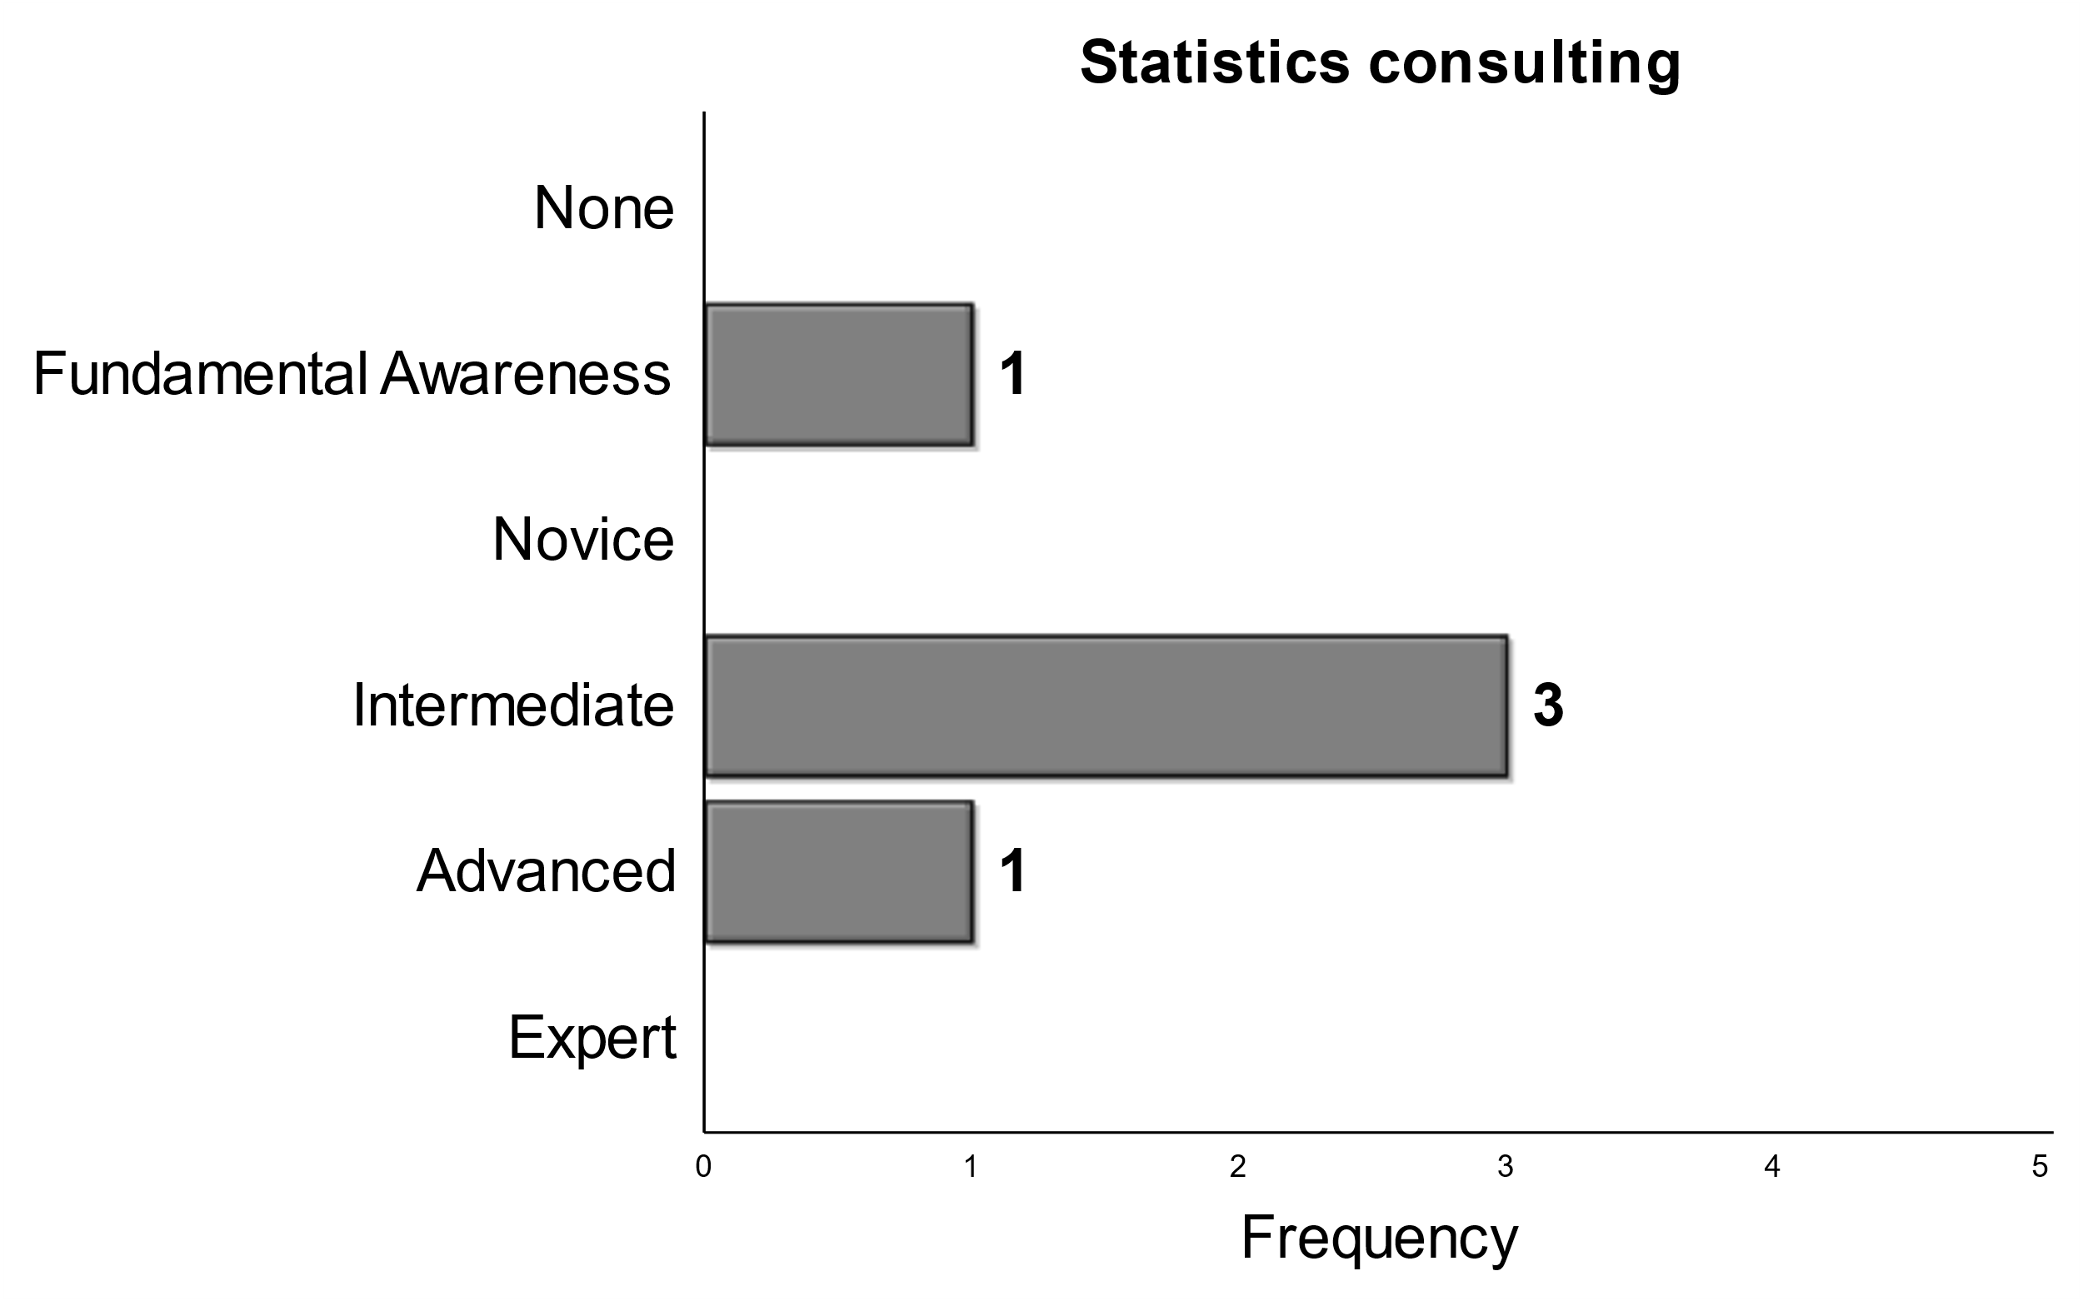
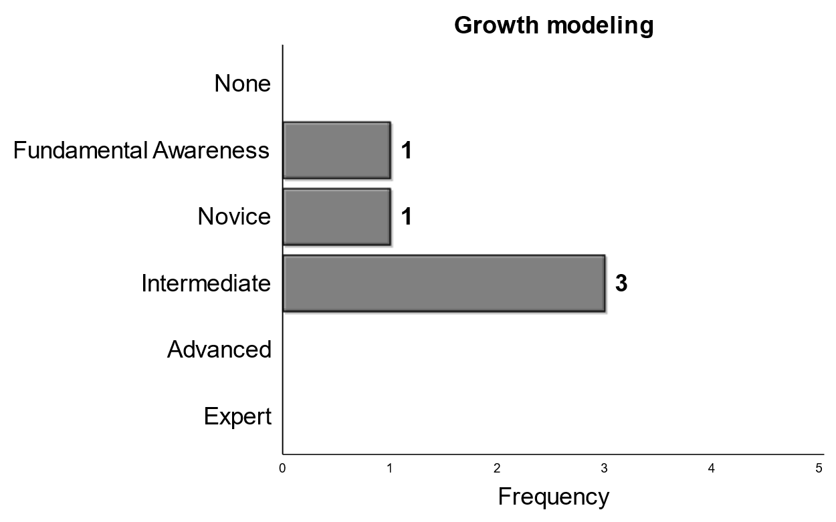
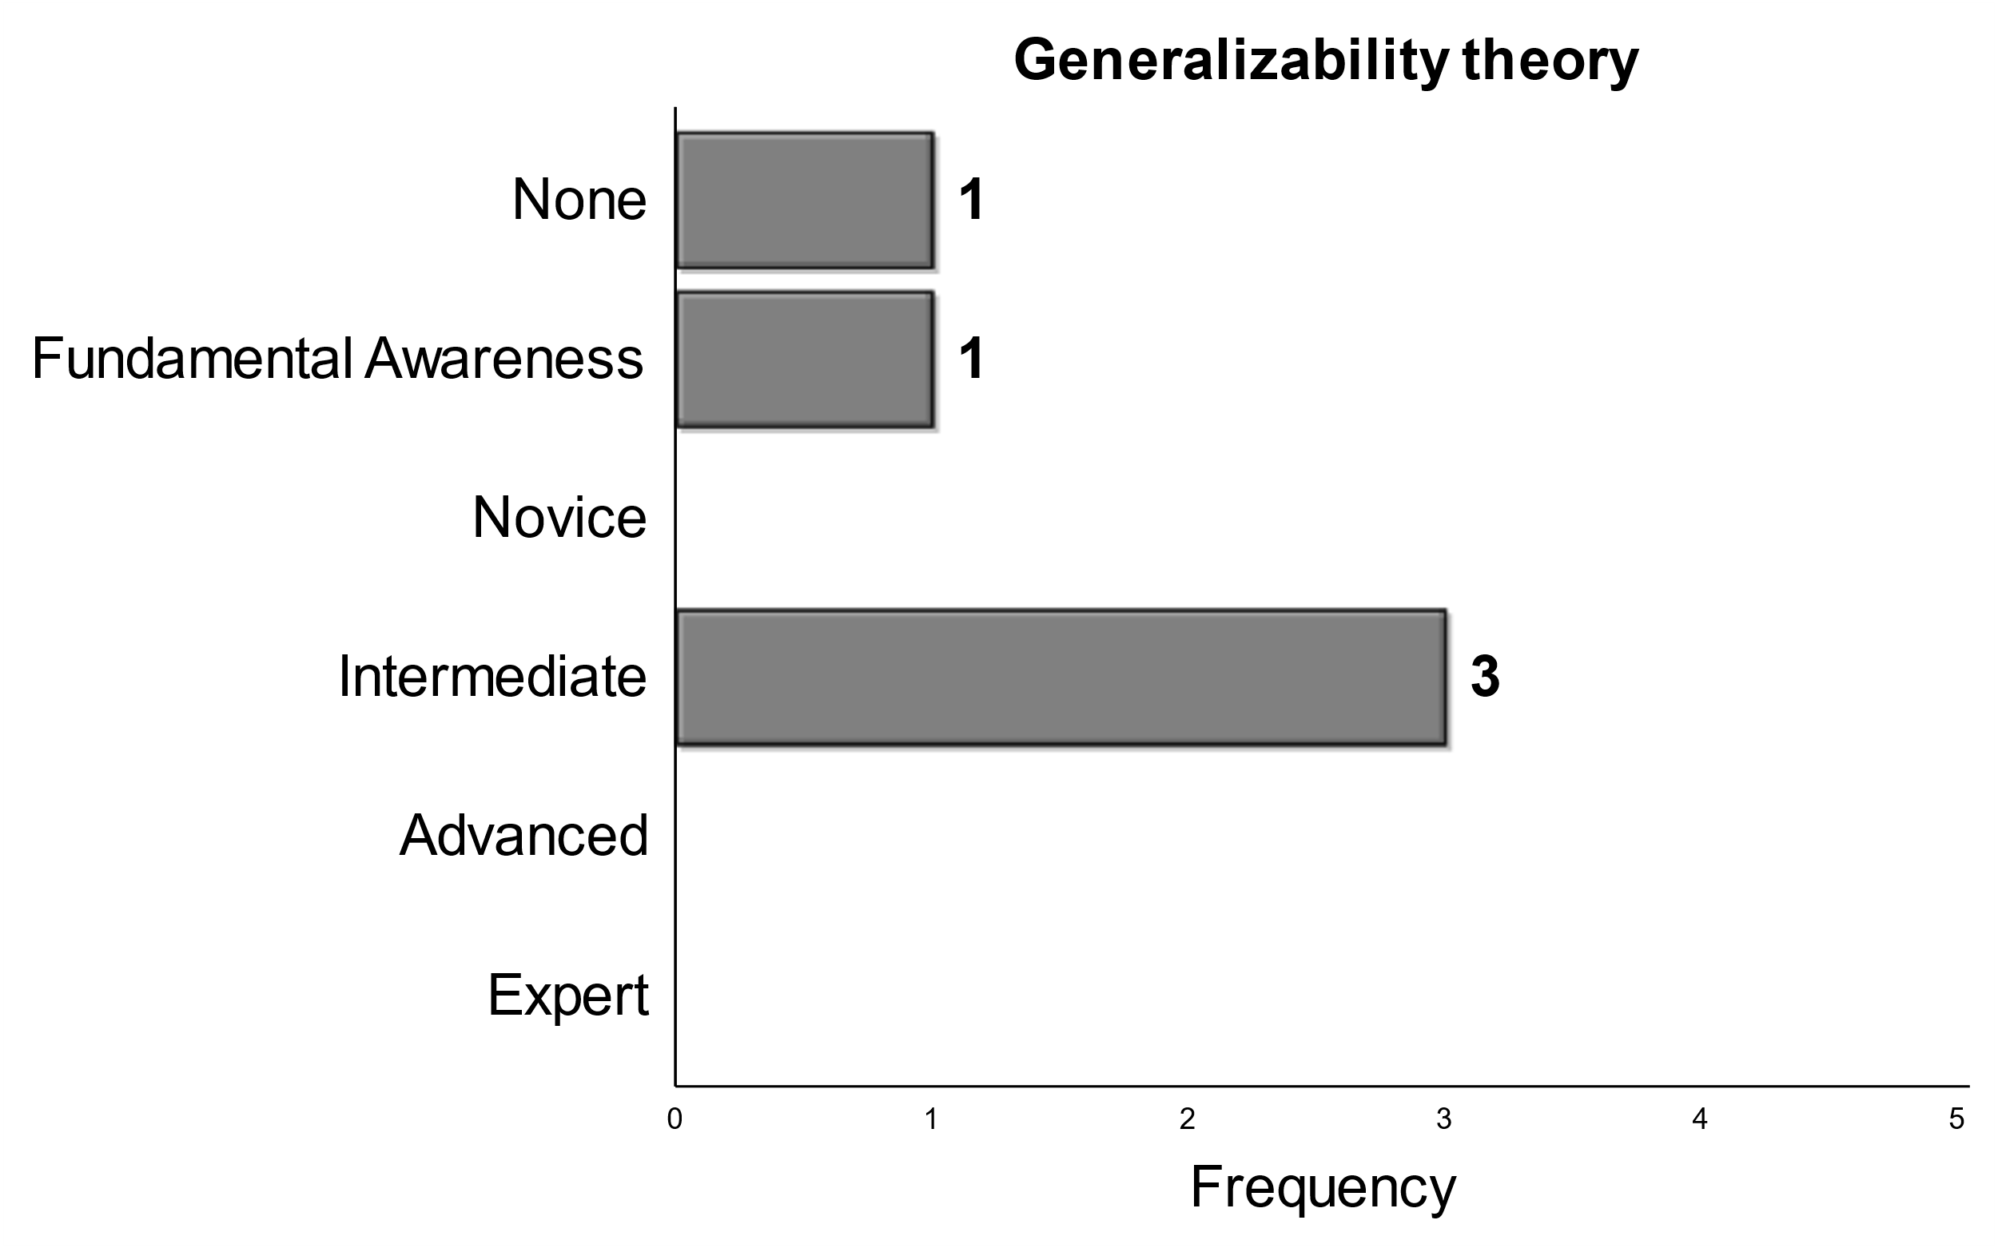
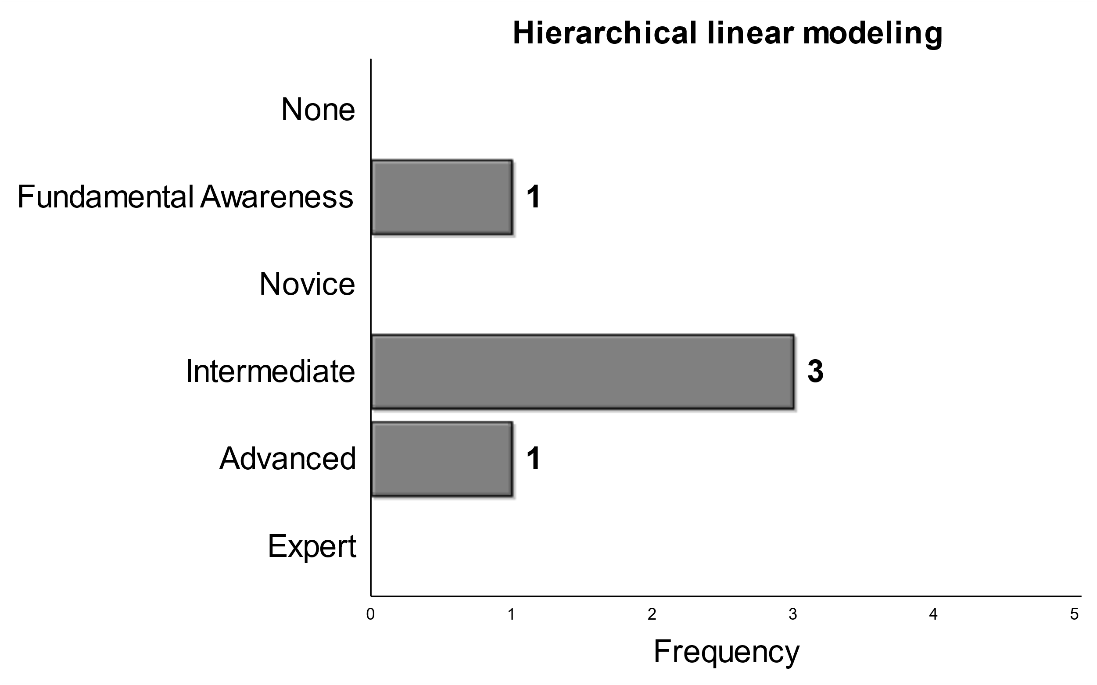
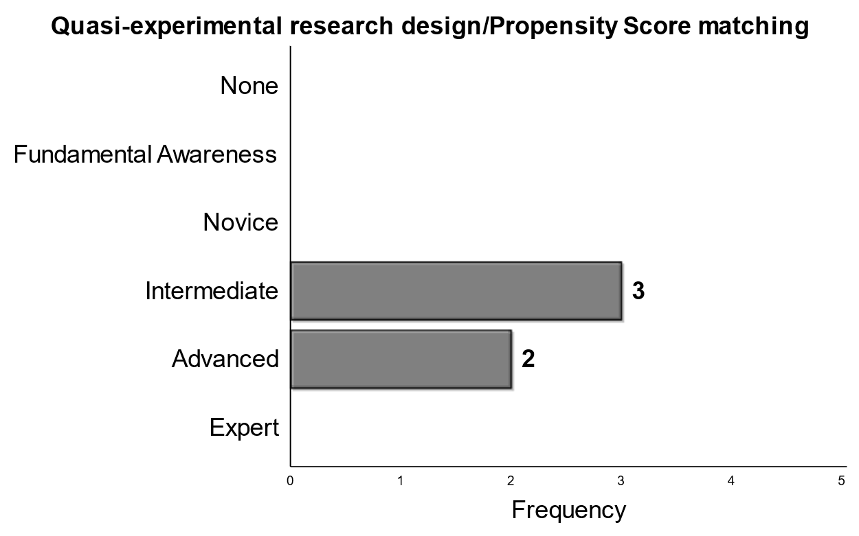

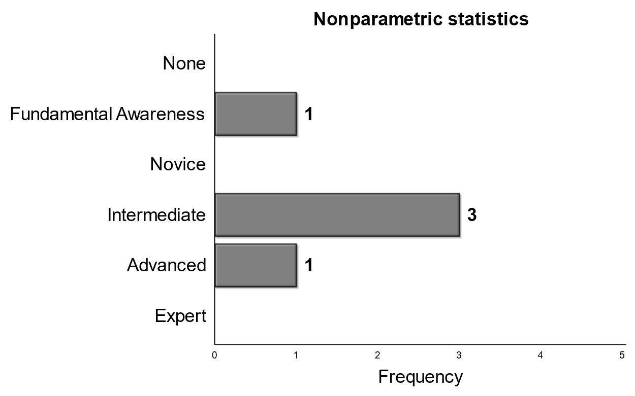
Majority - Intermediate
Higher Mean
Notes:
Here we see topics in which a majority of respondents selected intermediate. Again, the items within this category are ordered from least to greatest mean response from left to right on your screen. We see that a majority rate an intermediate skill level expected for generalizability theory, but the other two panelists rating it quite low, with one saying they don’t expect PhDs to have any knowledge or skill related to G theory. Meta-Analysis also saw a majority of panelists selecting intermediate, with the other two panelists split among fundamental awareness and novice expectations. Interestingly, panelists have the same split expectation for graduating PhdS with respect to their expected skill level on hierarchical linear modeling, nonparametric statistics, and statistics consulting. Finally, there was a high expected for Phd skills with respect to quasi-experimental research design and propensity score matching.

Slide 11
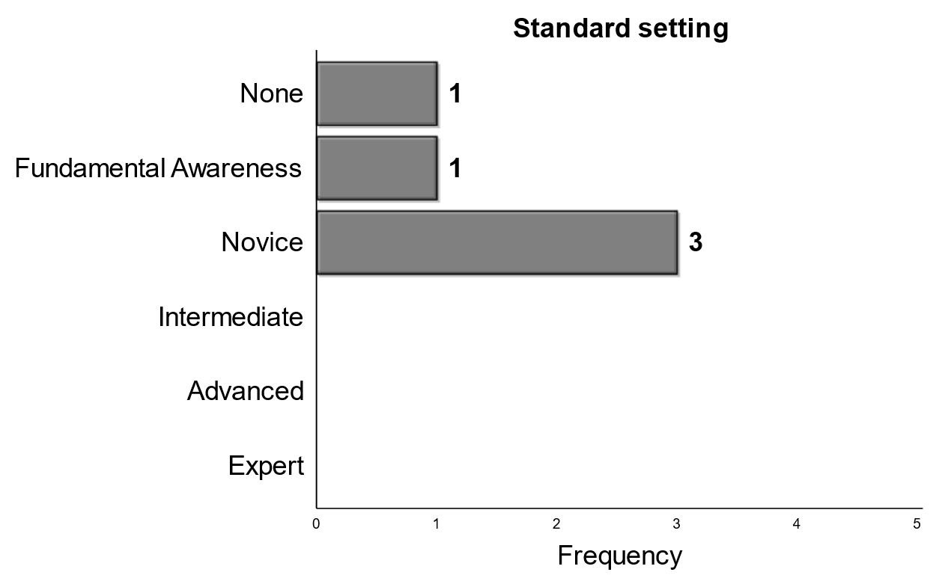
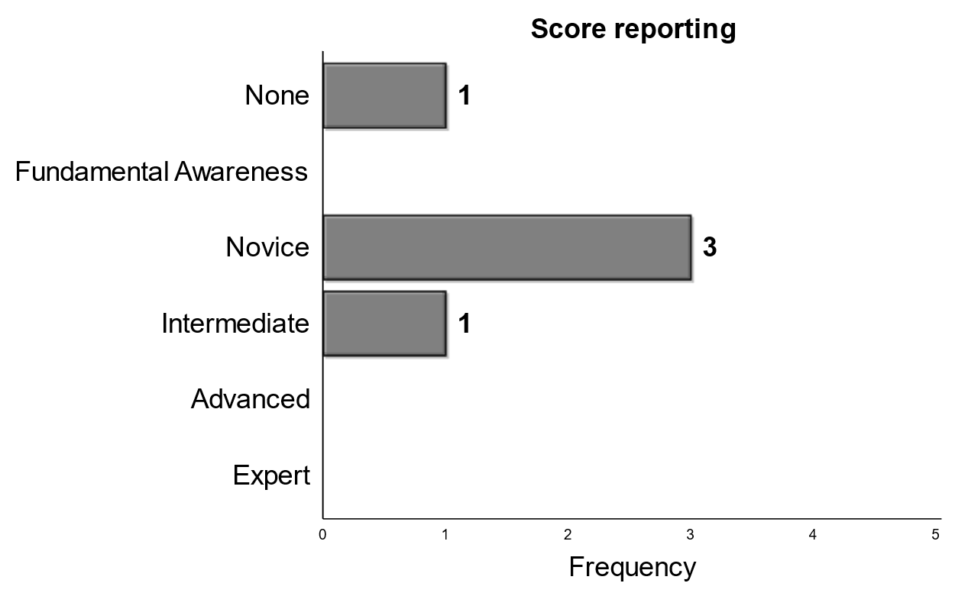
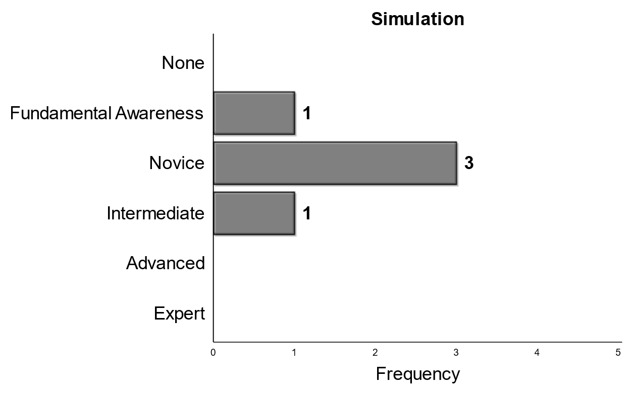
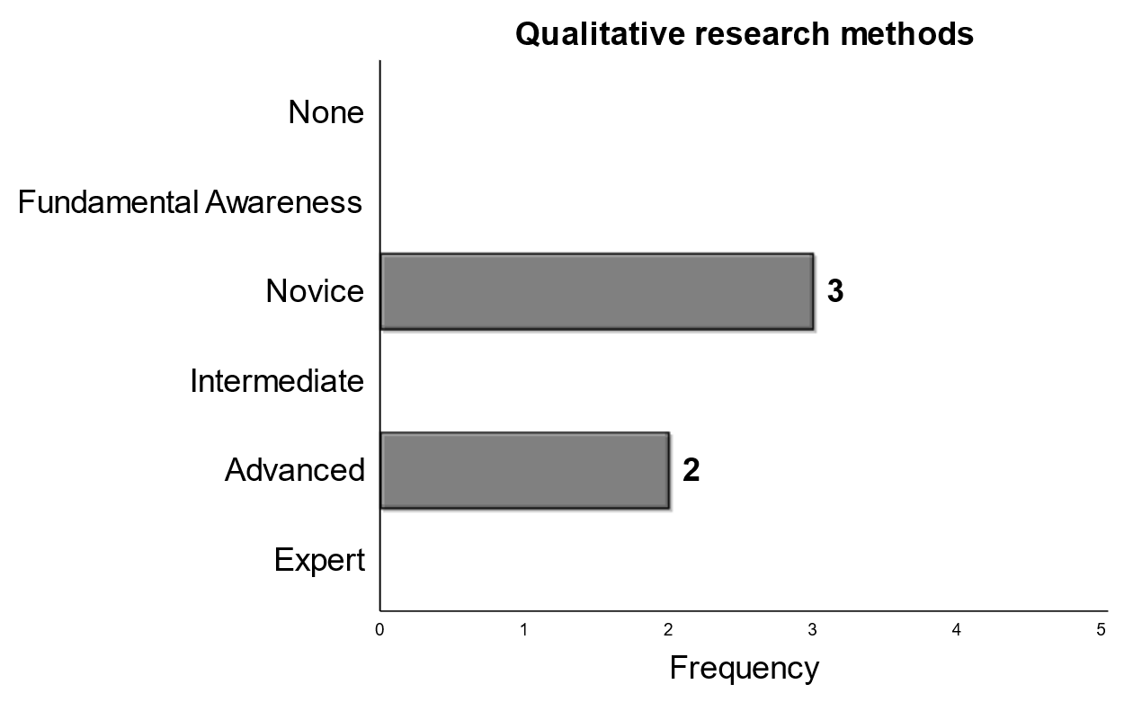
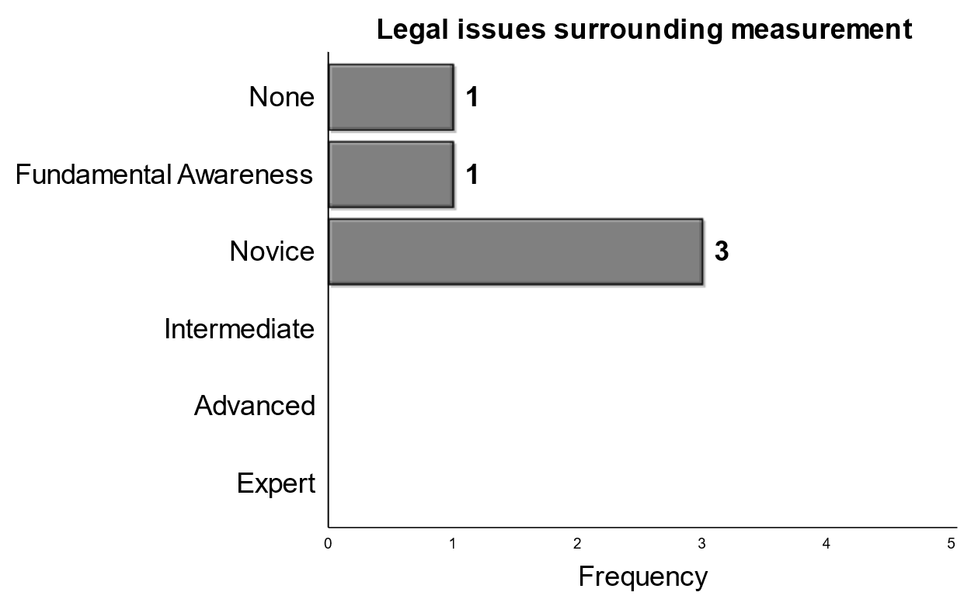
Majority - Novice
Higher Mean
Notes:
Here we present the topics in which a majority of respondents selected a novice level of expected skill where qualitative research methods had a bimodal split with two panelists picking an advanced level of expected skill.

Slide 12
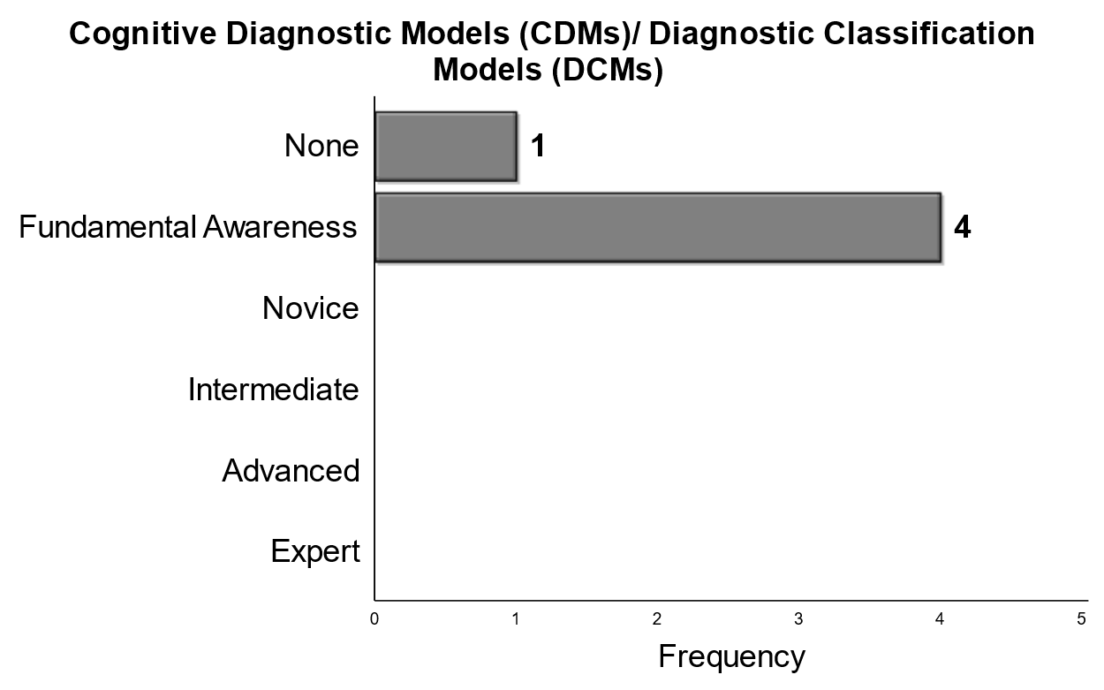
Majority – Fundamental Awareness
Higher Mean
Notes:
Cognitive Diagnostic models/diagnostic classification models is the one stand alone topic that was rated the lowest by consensus.

Slide 13
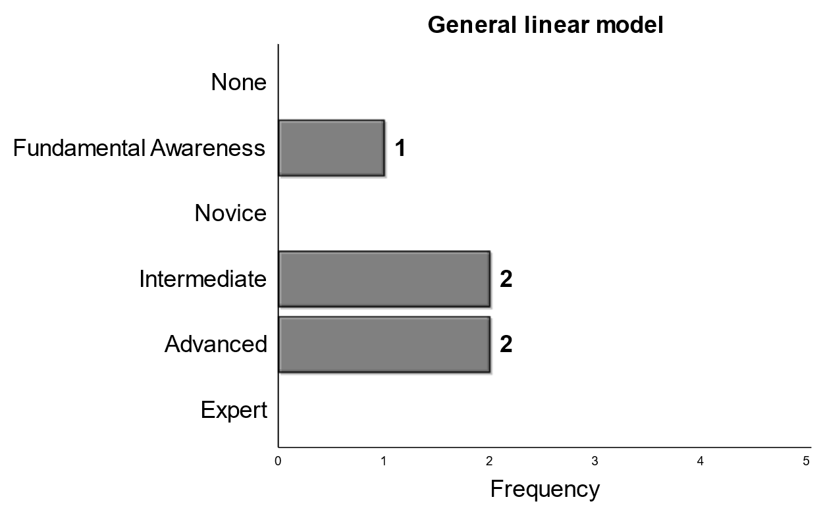
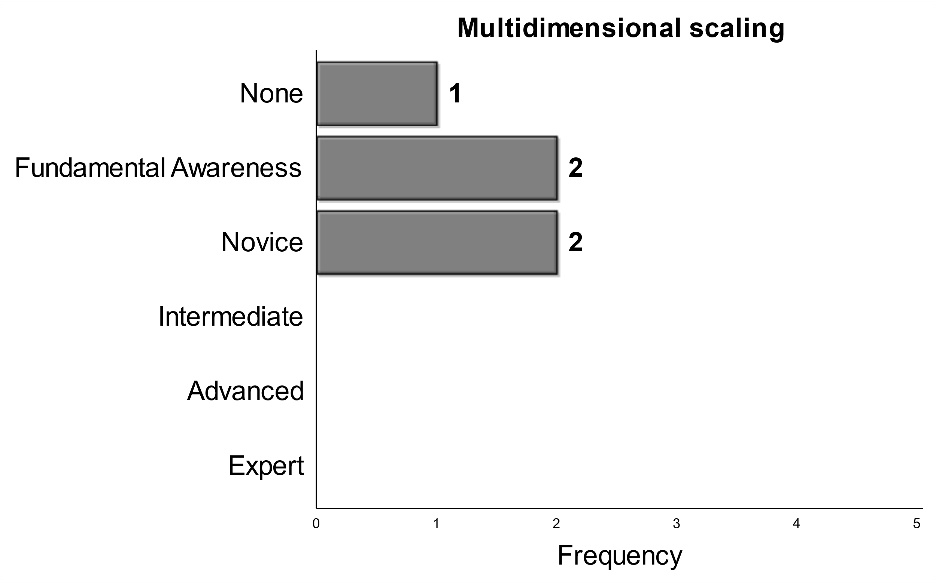
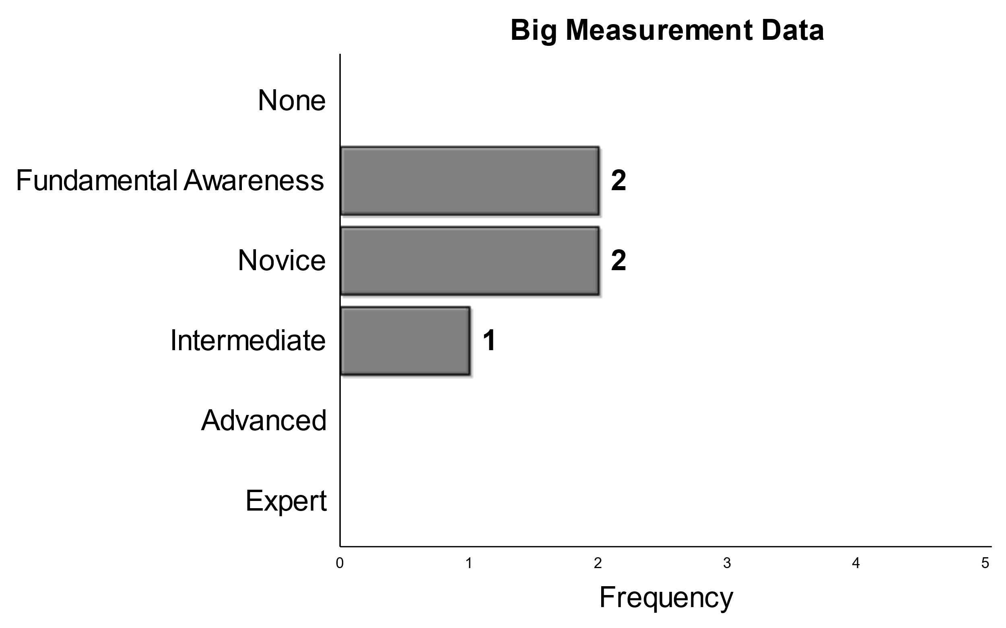
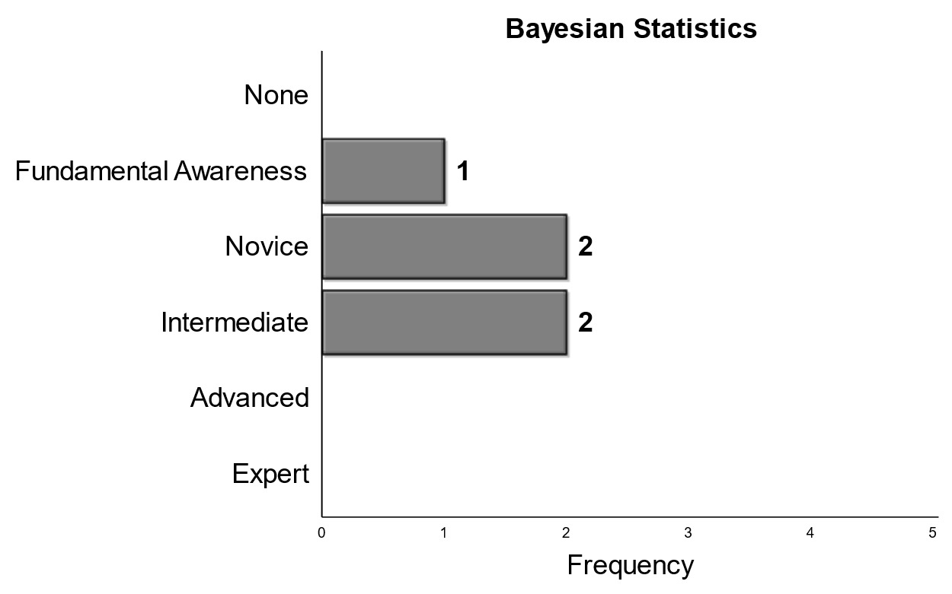
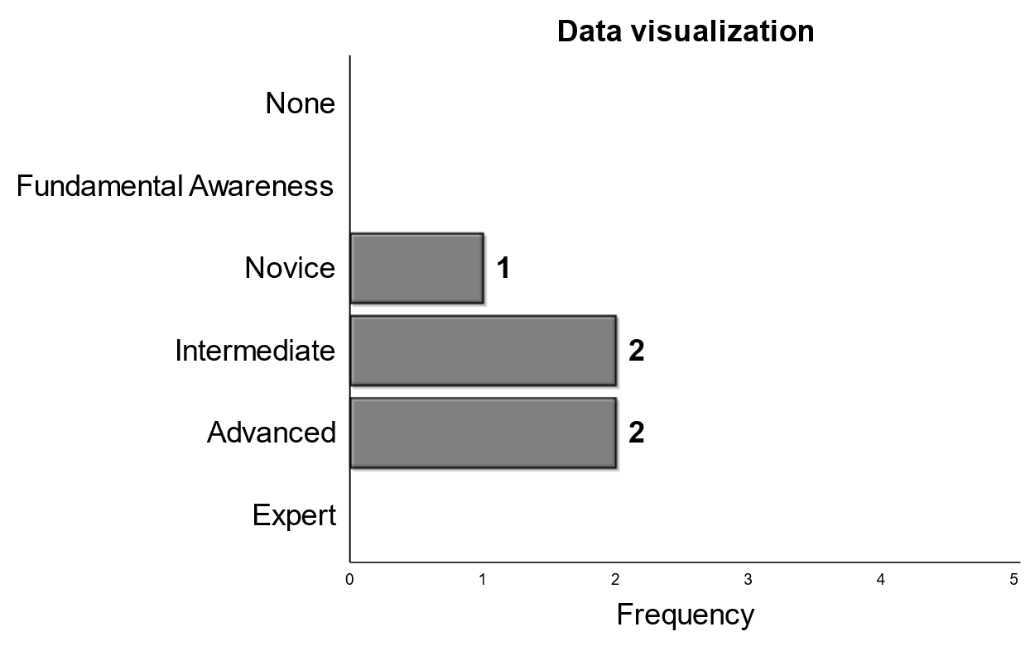

Split, but grouped
Higher Mean
Notes:
For the next three slides, we will present topics where no majority existed for panelists. Here we see panelists split among response options, but generally close with their ratings being in similar locations on the response scale. The final column, specifically general linear modeling, data visualization and programming, we see panelists split, but facvoring either intermediate or advanced expected skill. Comapratively, panelists were grouped on the lower end of the response scale for multidiemsnional scaling with one panelists expected no level of skill for graduating Phds.

Slide 14
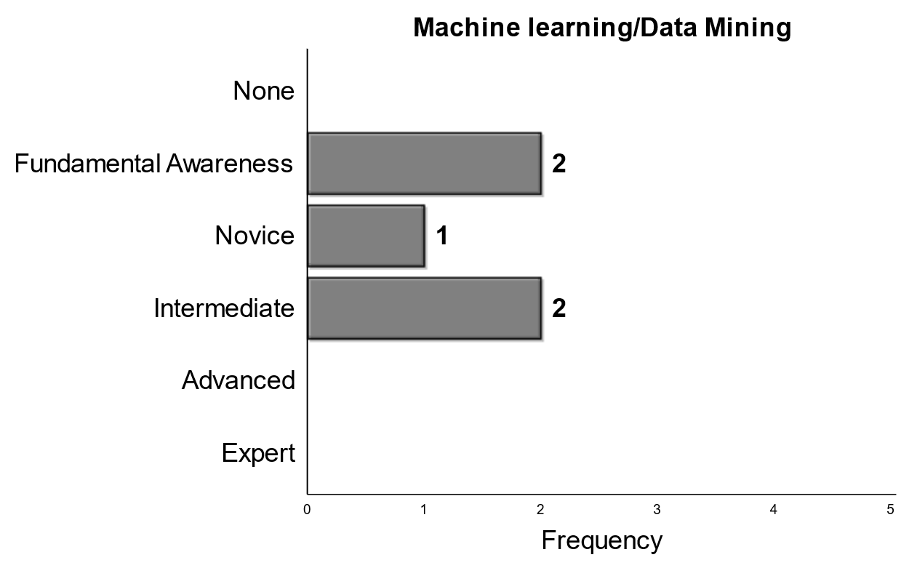
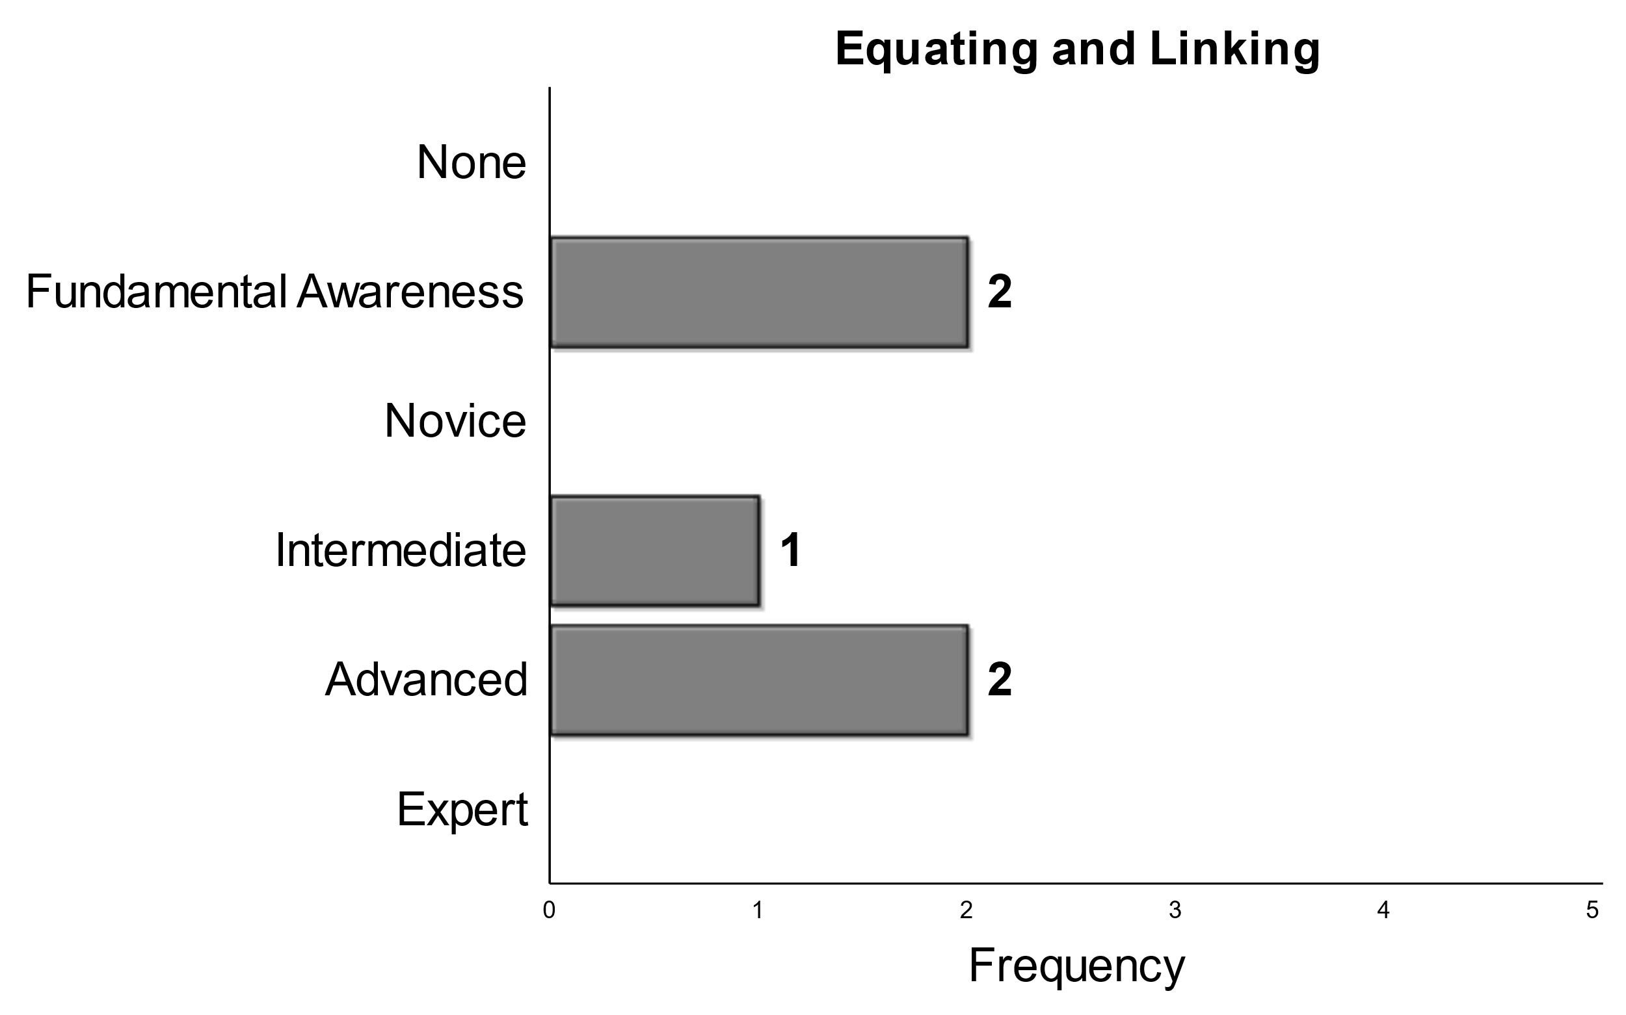
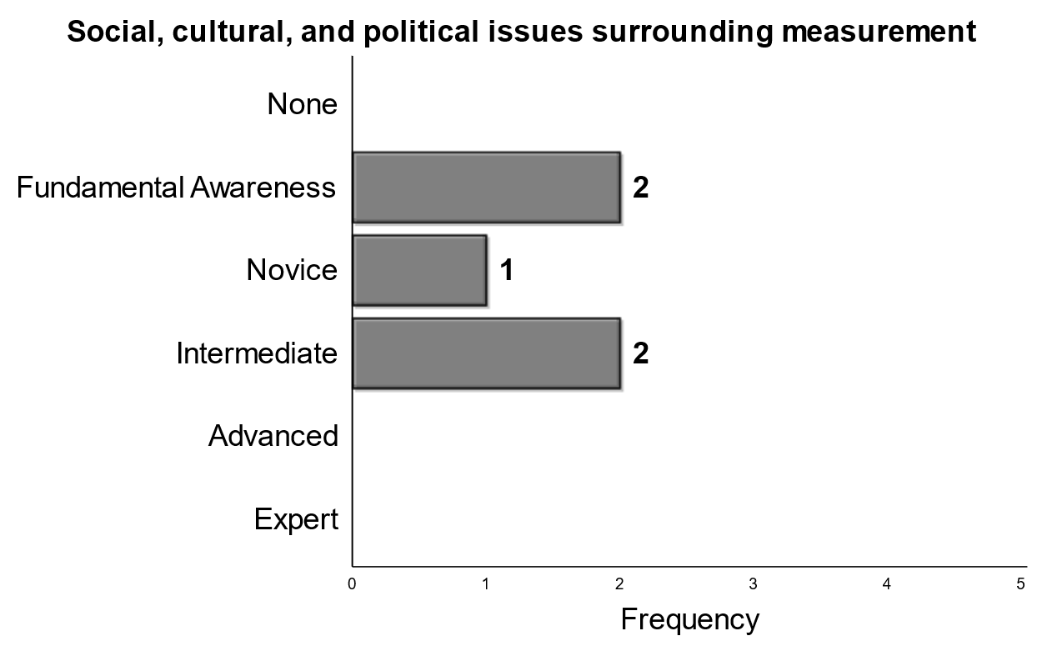
Split - Bi-modal
Higher Mean
Notes:
These three items had panelists split with two modes. We see machine learning/data mining and equating/linking skills with the split. Noticeable is a large gap between expectations for equating an dlinking with two panelists expecting on a fundamental awareness and two panelists expecting an advanced level of expertise. Although all panelists had some expectation for graduating Phds with reelect to cultural, social, and political issues surrounding measurement they were split.

Slide 15
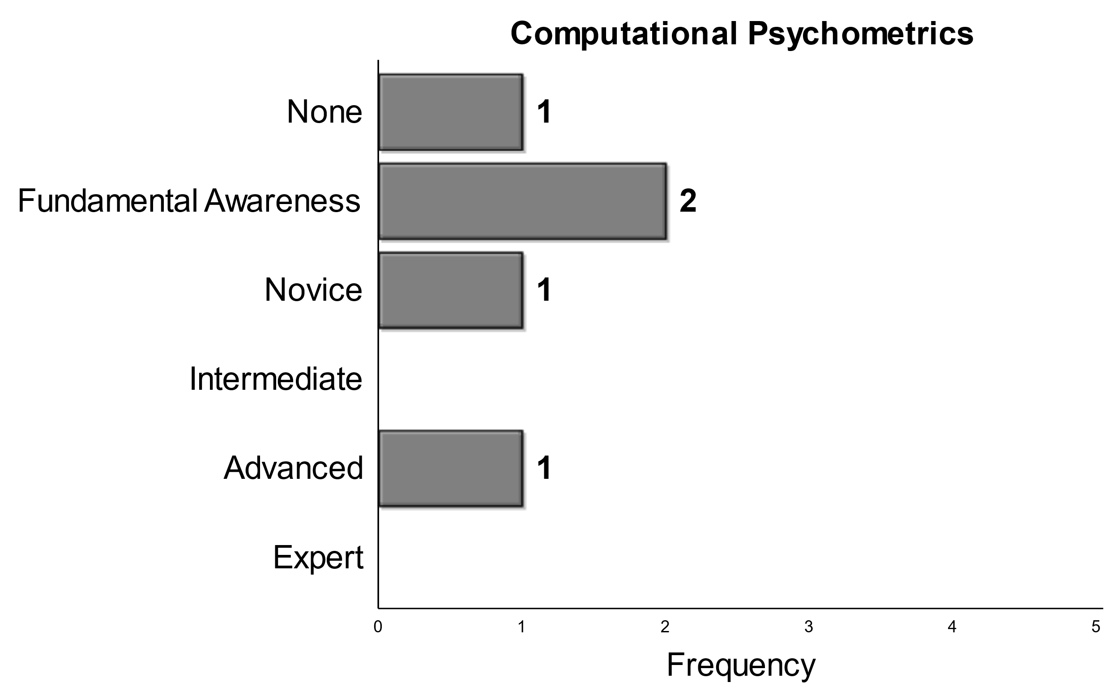
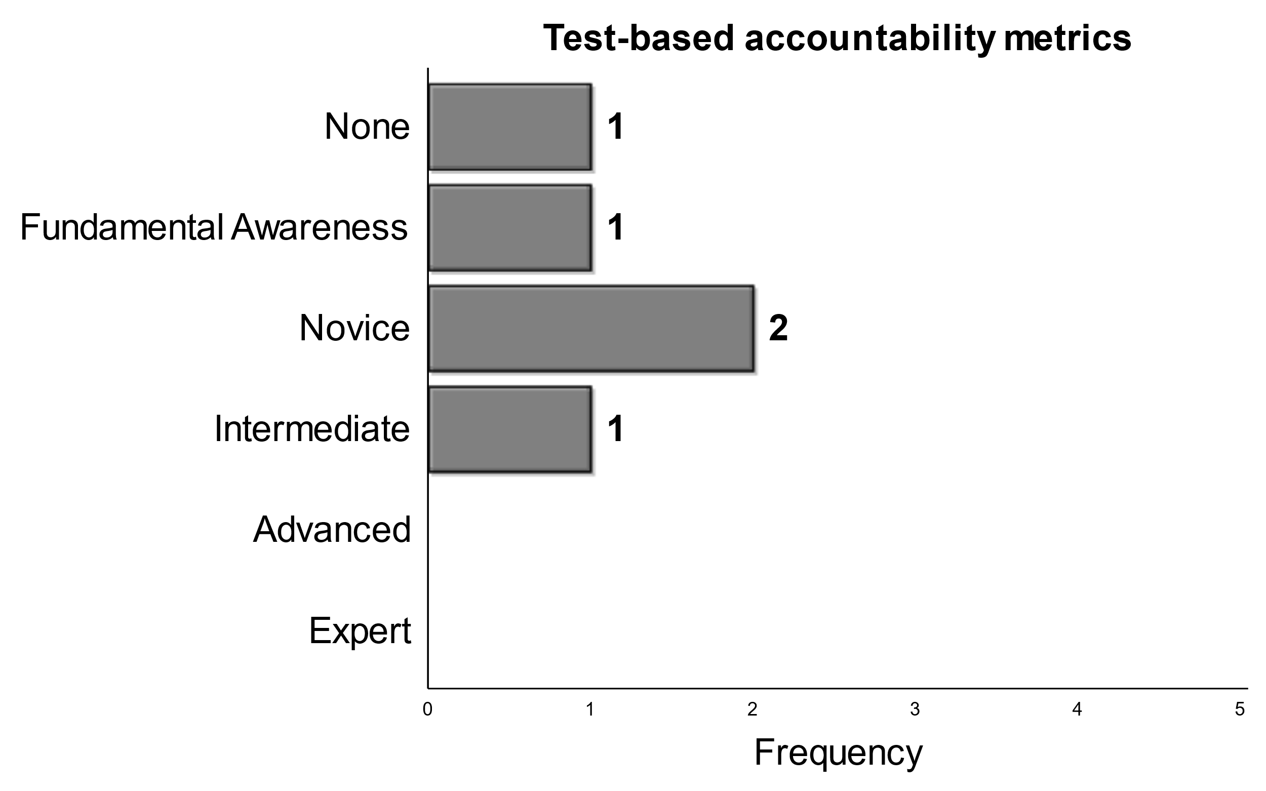
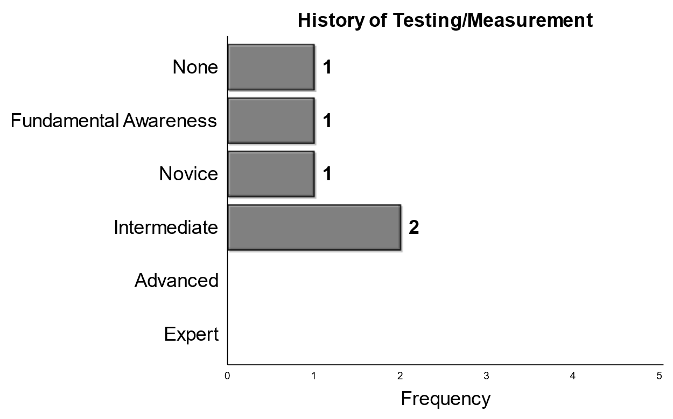
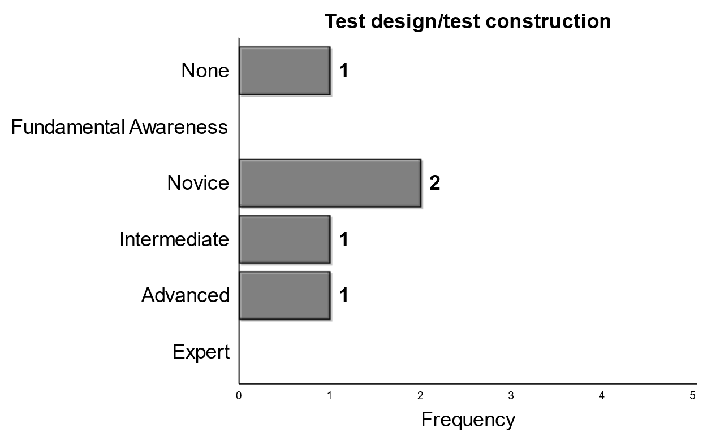
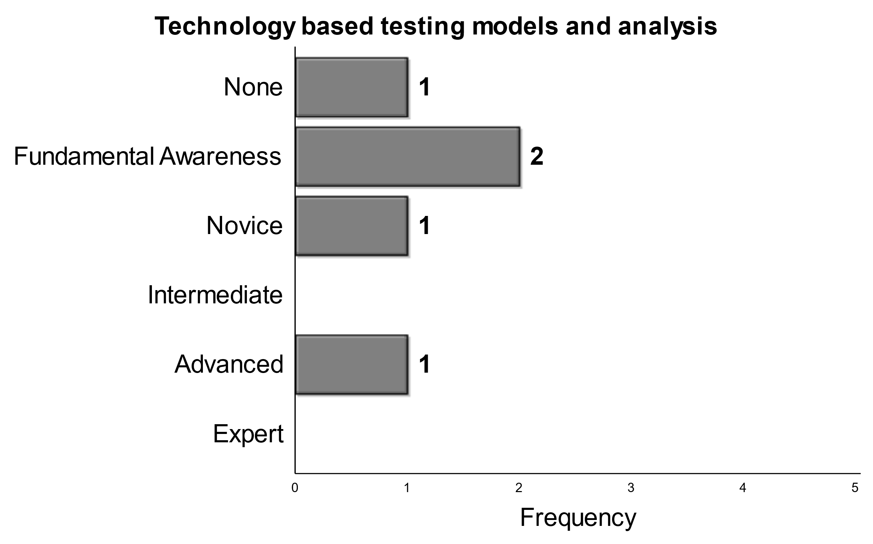
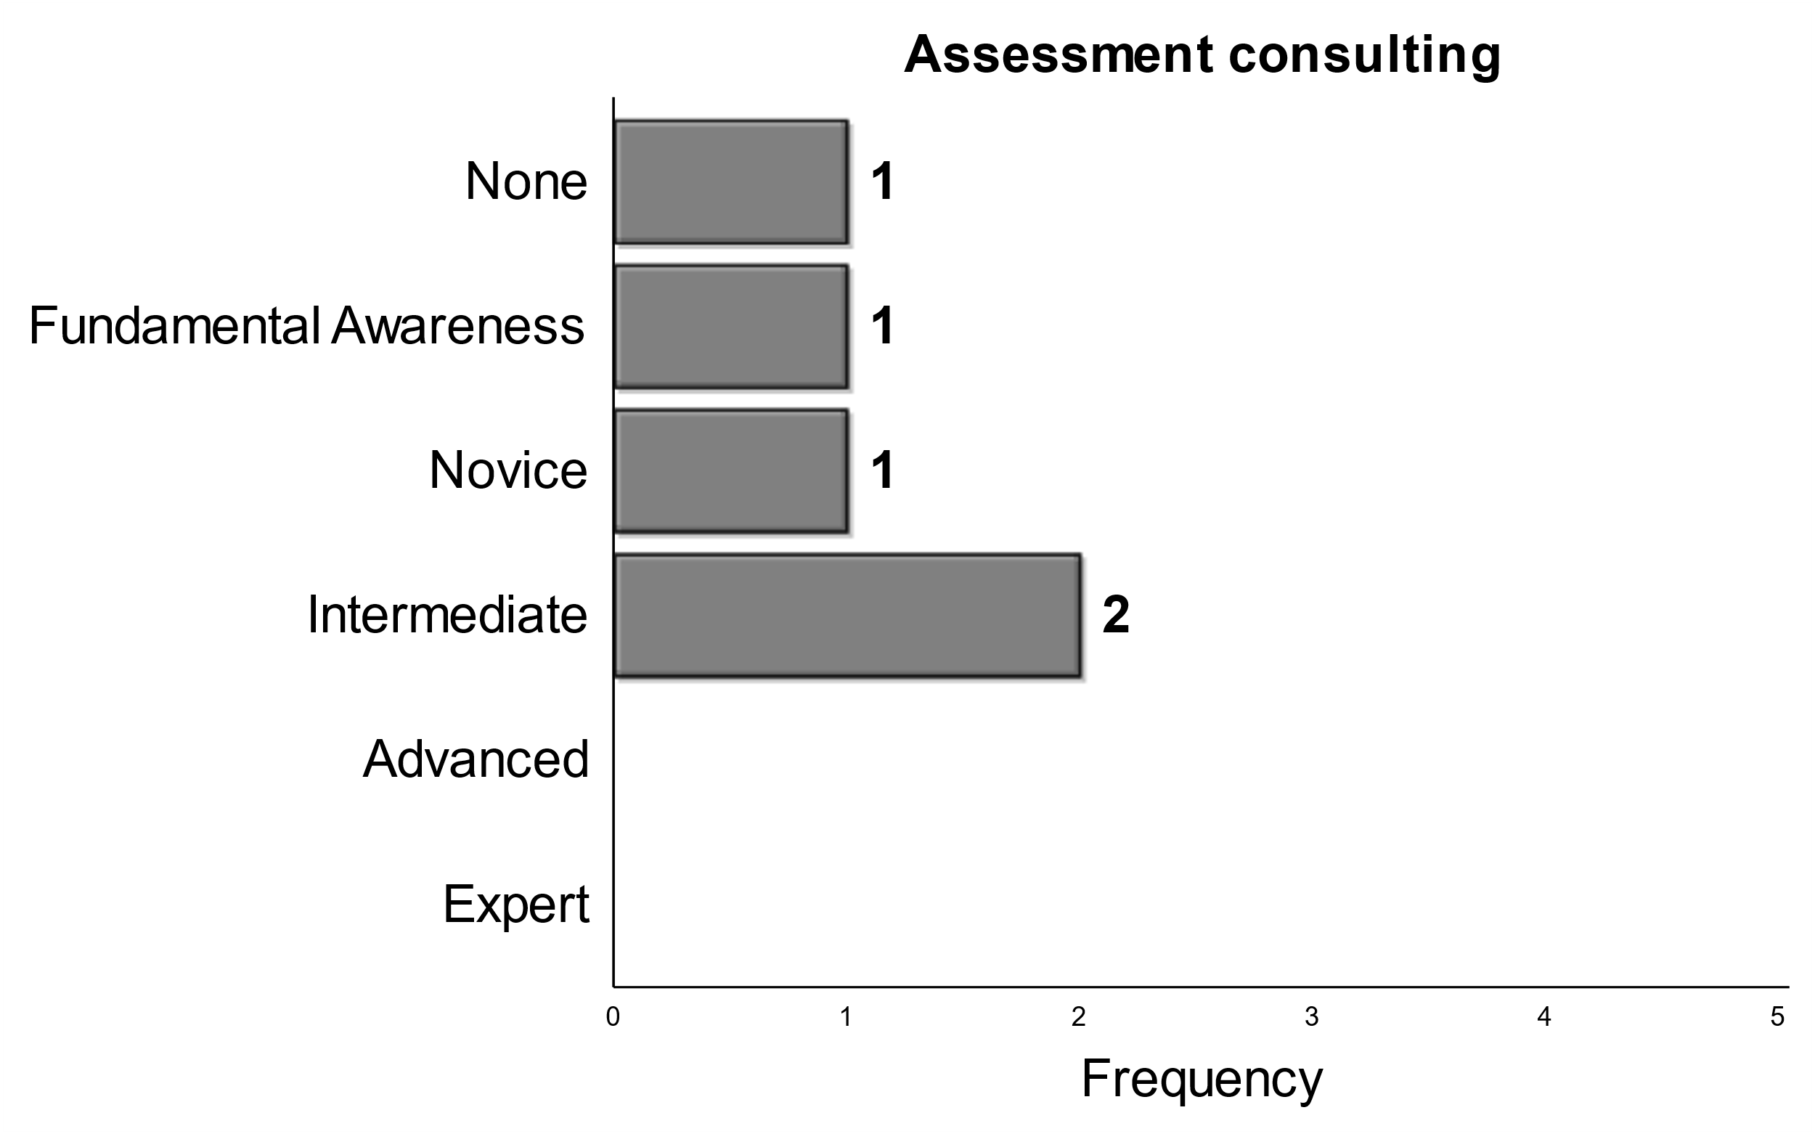
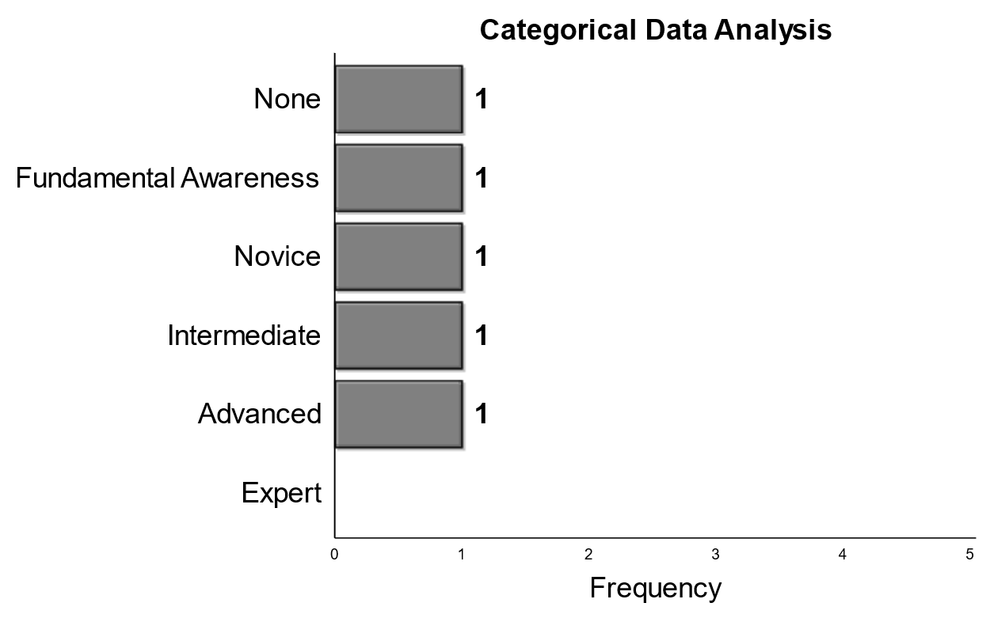
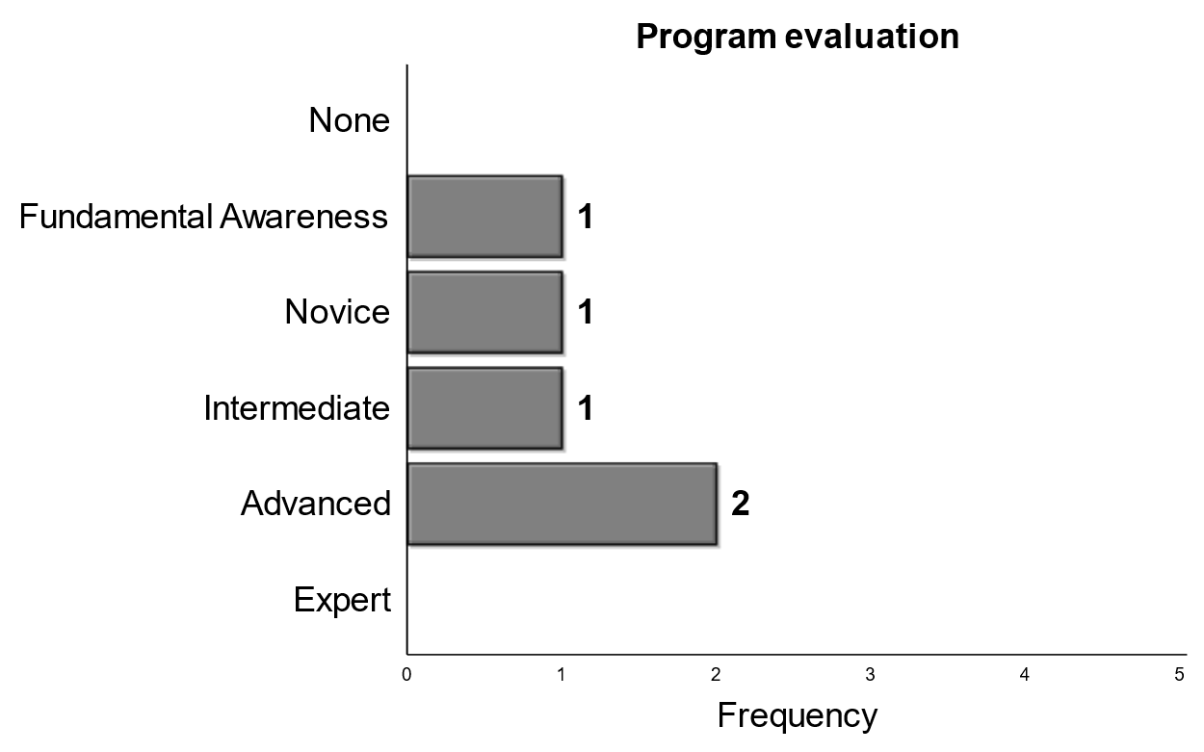
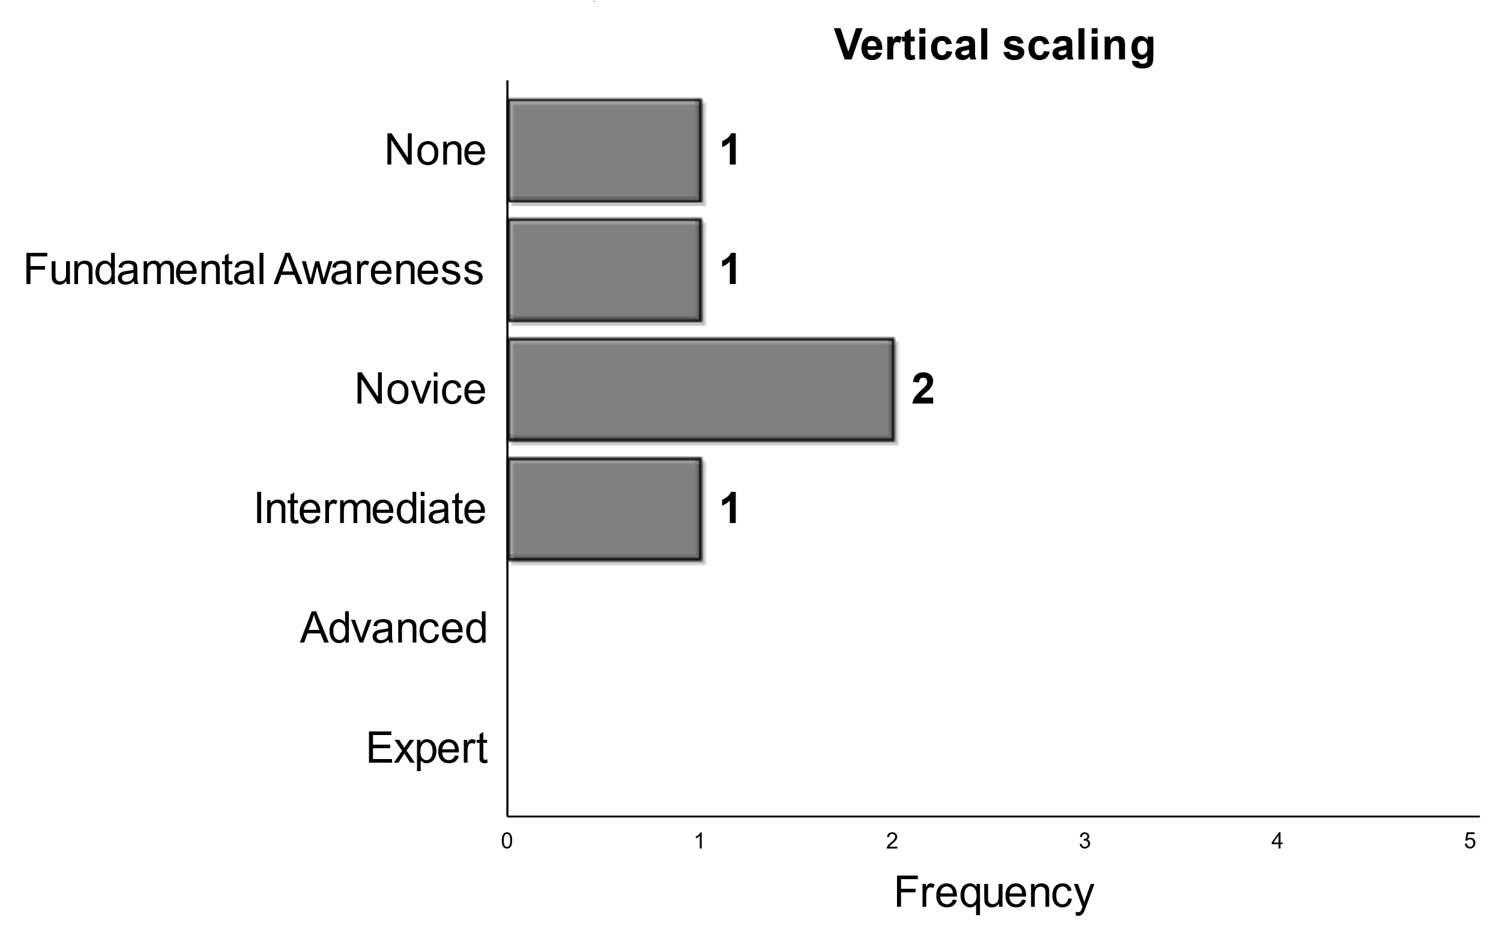

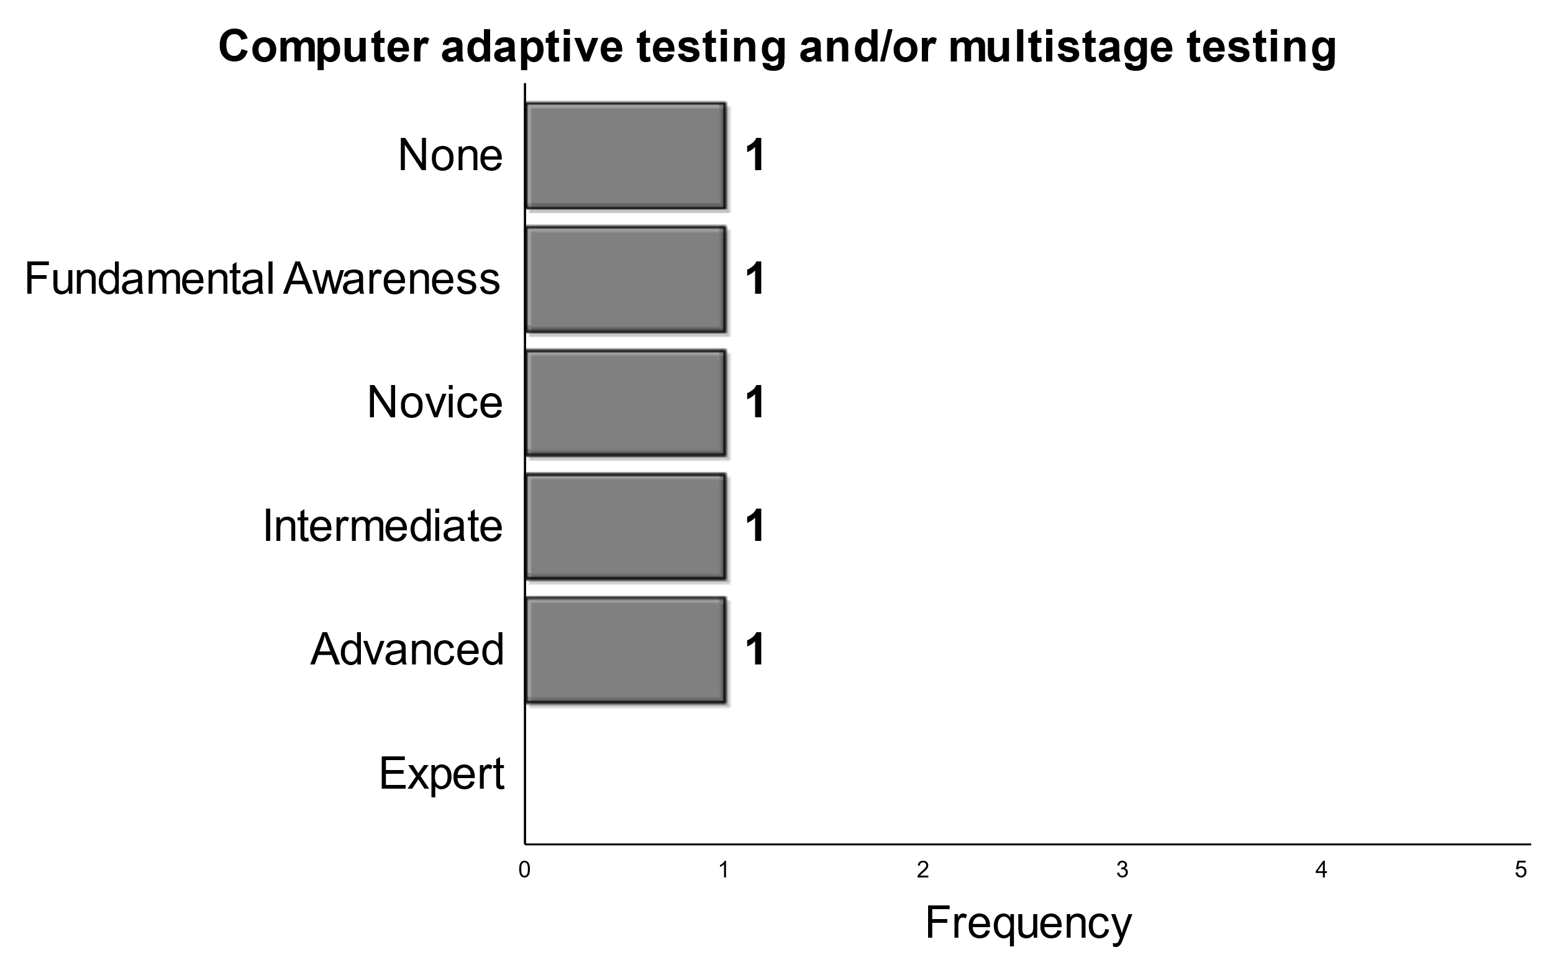
Split, inconsistency
Higher Mean
Notes:
Here we present that topics that were most split. WE see that panelists were torn on expected skills of graduating Phds for Categorical data analysis and computer adaptative testing and multistage testing. Panelists had varying expectations for vertical scaling, assessment consulting, cognitive sciences and PhD experience with history of testing/measurement. For computational psychometrics, technology based testing models, and test design/test construction we had one panelist selected advanced and one panelist say they expected graduating phds to have no skill with the other panelists selecting a mix of responses in between. Finally there was a negative skew expectation of skills surrounding program evaluation, but panelists were torn.

Slide 16

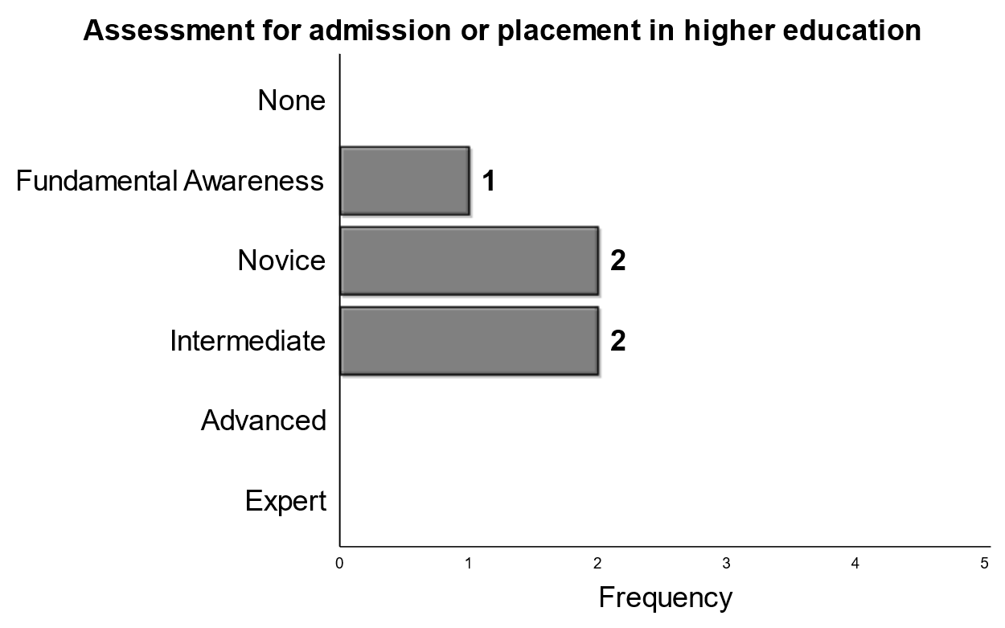
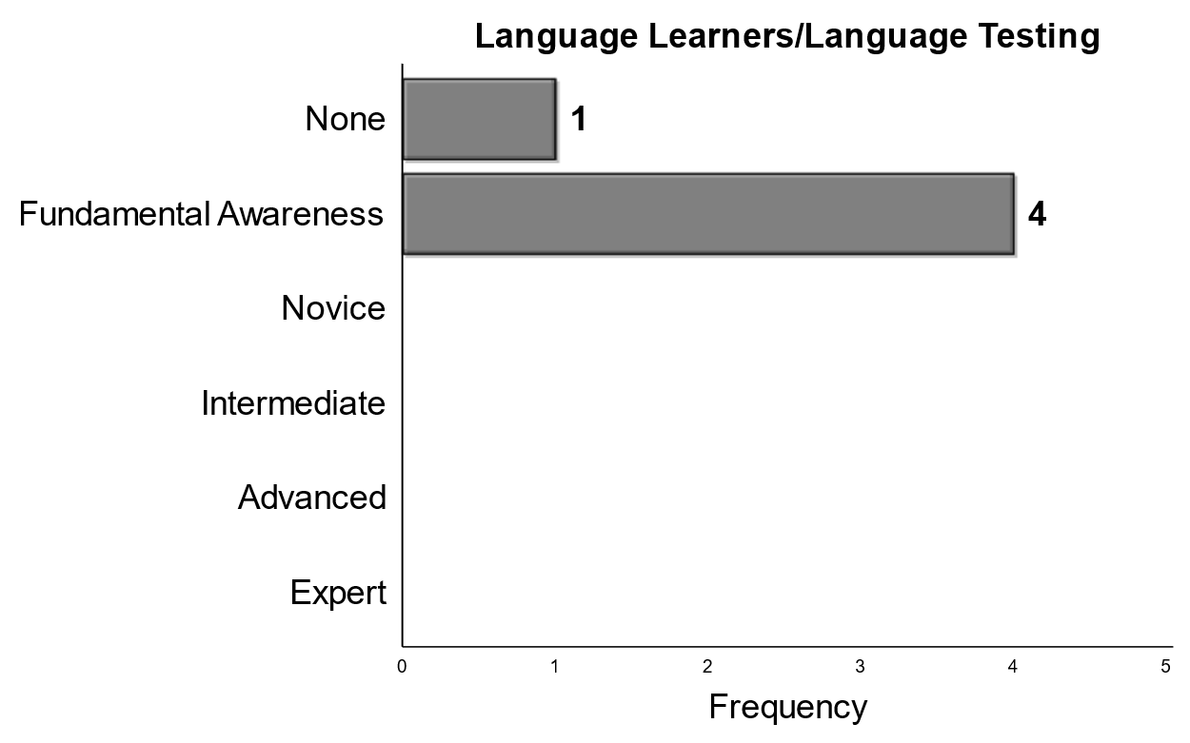
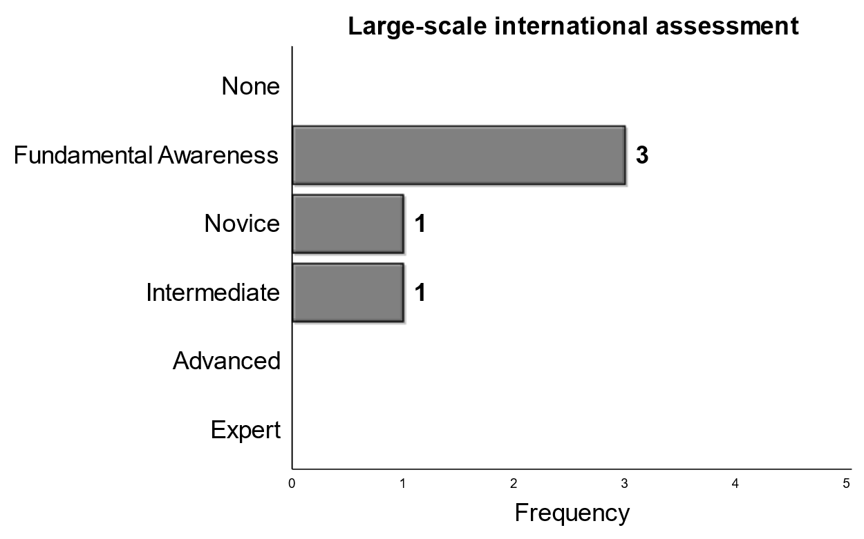

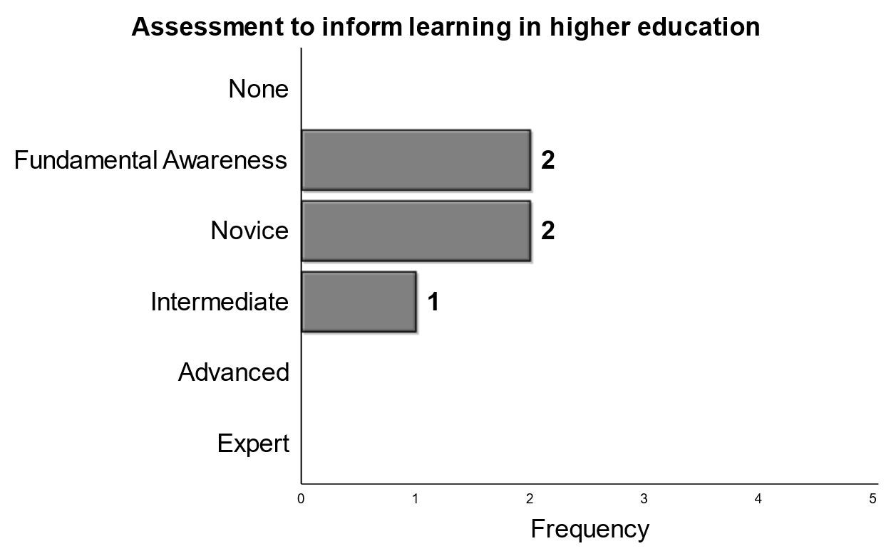
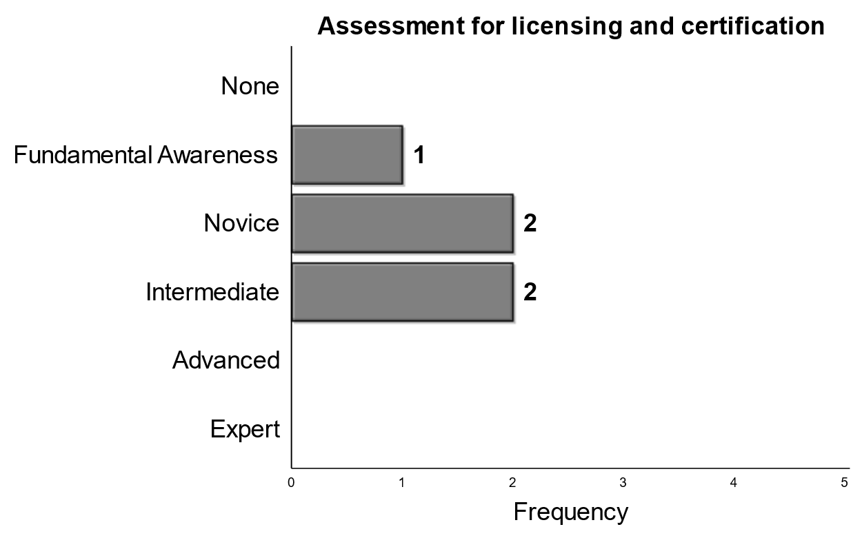

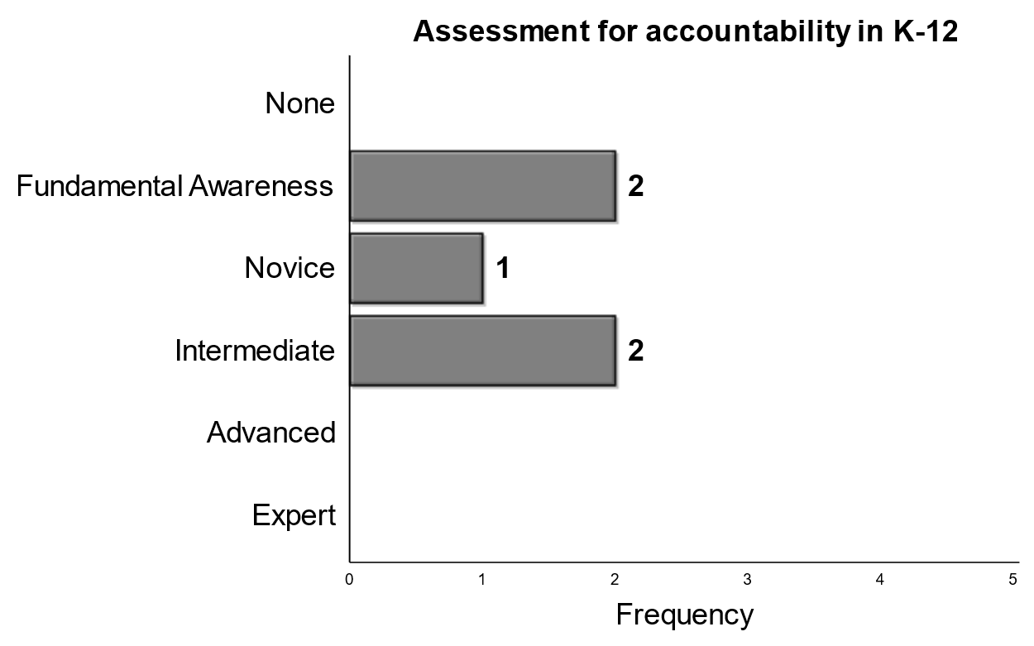

Specific Testing Types
K-12
Higher Education
Other
Notes:
Thinking about hiding this slide and only bringing it in if we have time…
This is more of an applications based slide.

Slide 17
Discussion Questions

Slide 18
Soft Skills

Slide 19
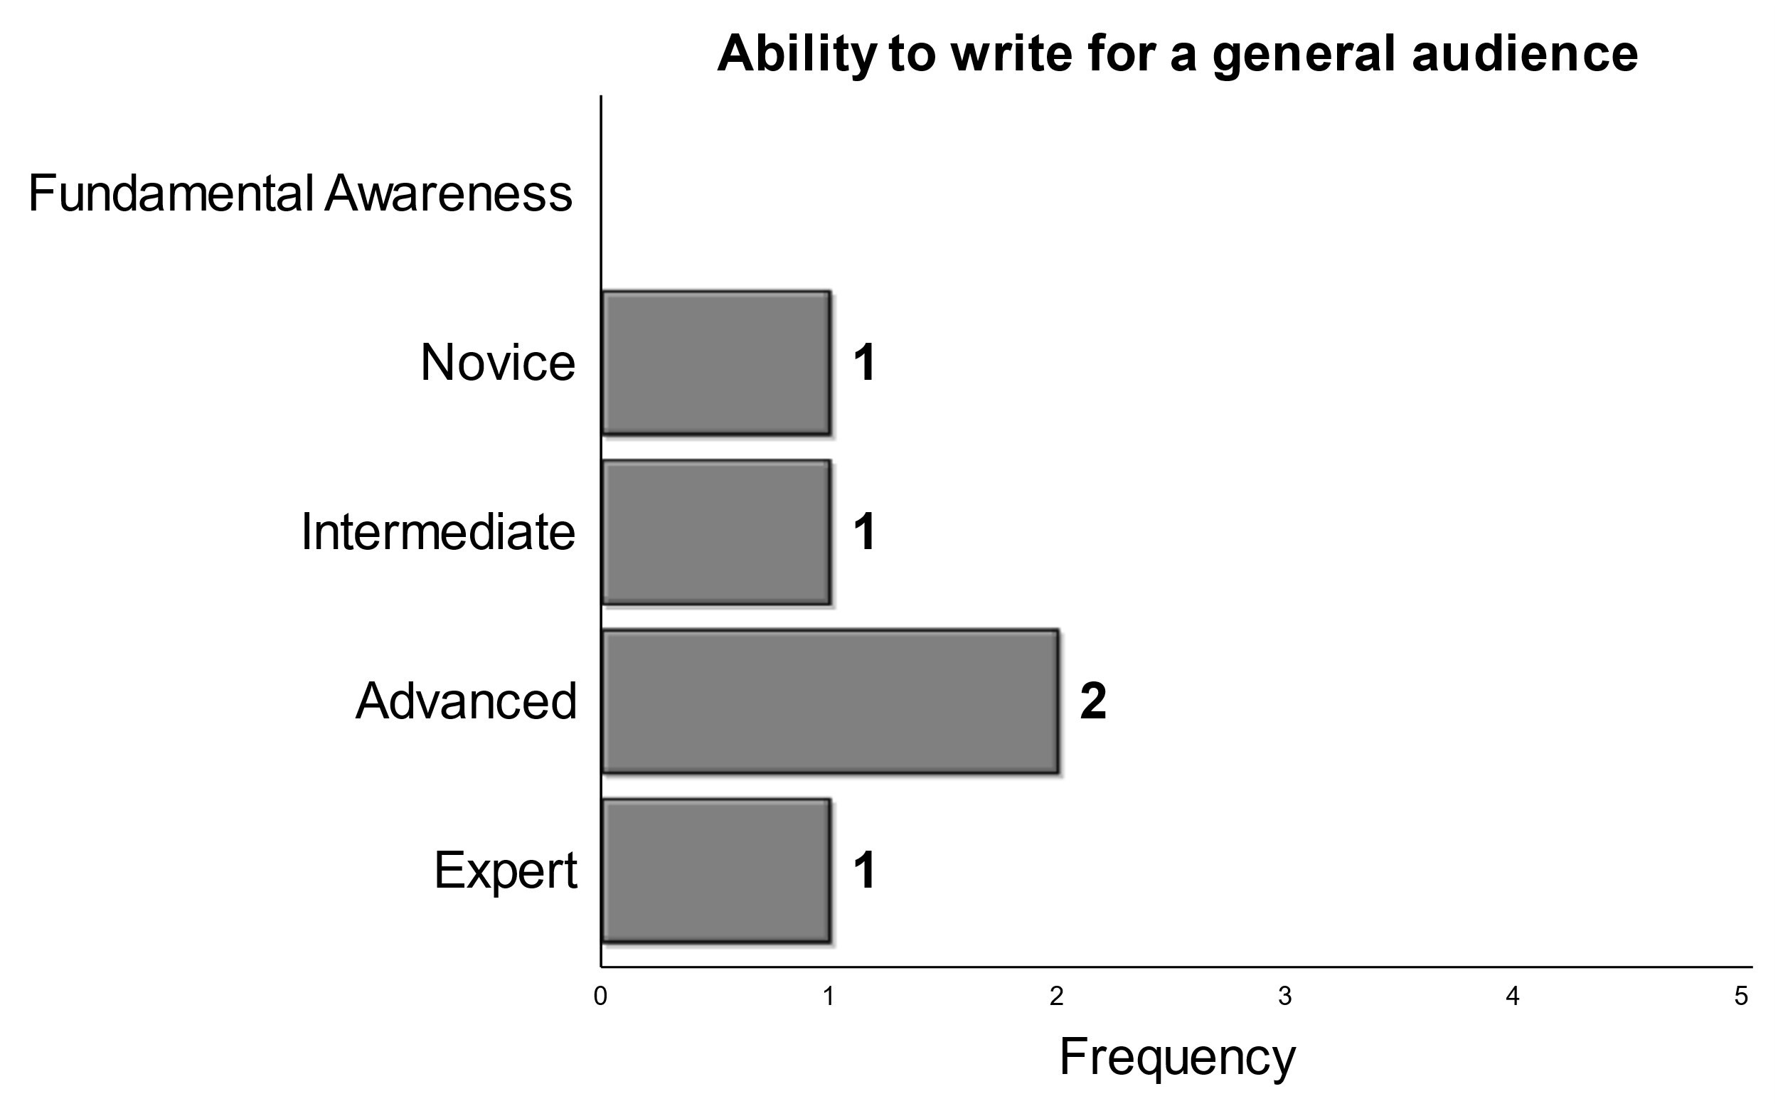
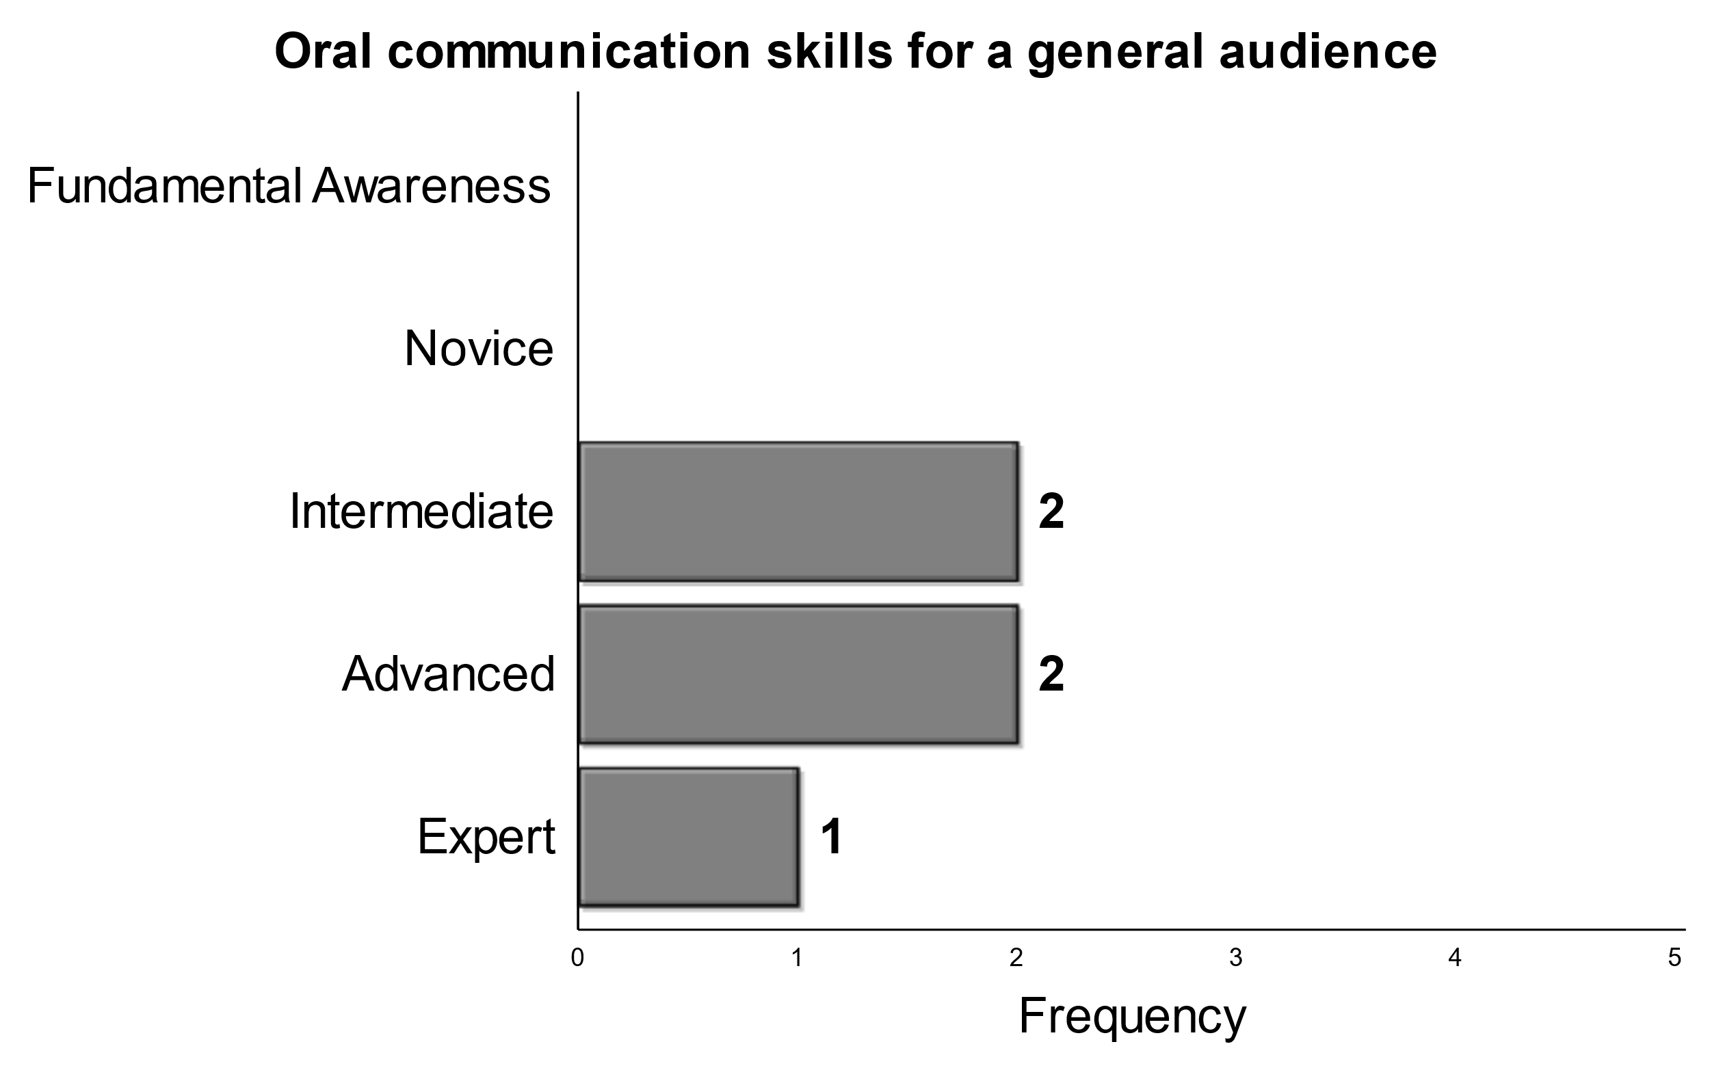
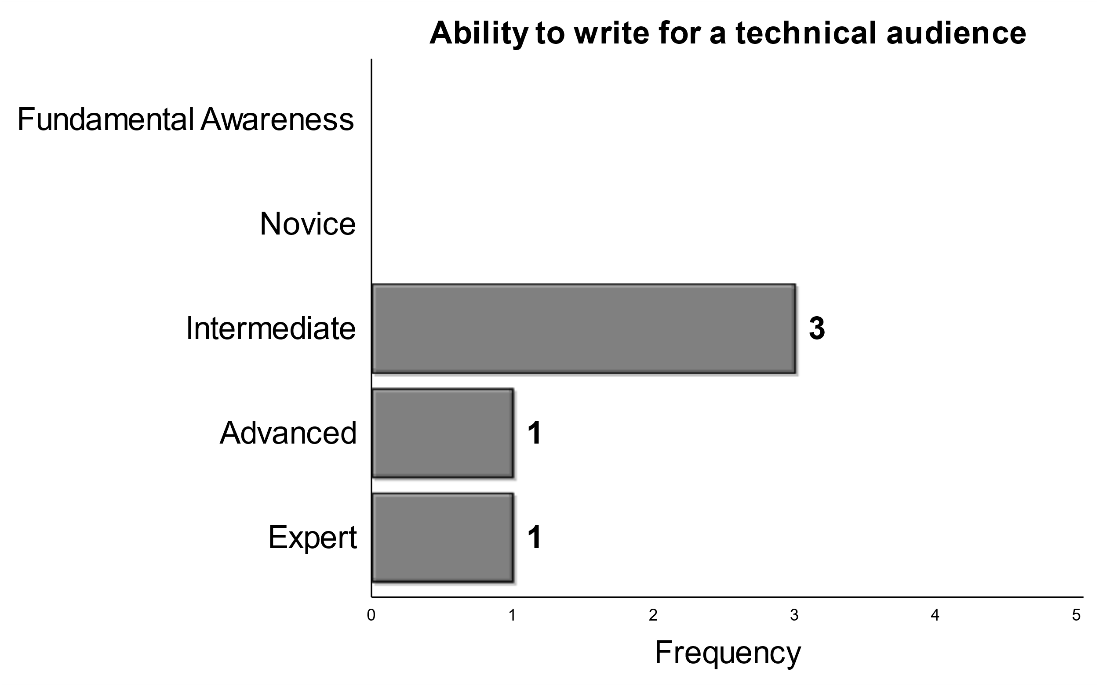

Communication
Written Communication
Oral Communication
Notes:
First, we will discuss written and oral communication skills. Panelists tended to agree of at least an intermediate skill level for all types of communication with the expectation of the ability to write for a general audience. There was a higher average expectation for oral communication of each type compared to written communication, but in general, all panelists have high expectations here.

Slide 20
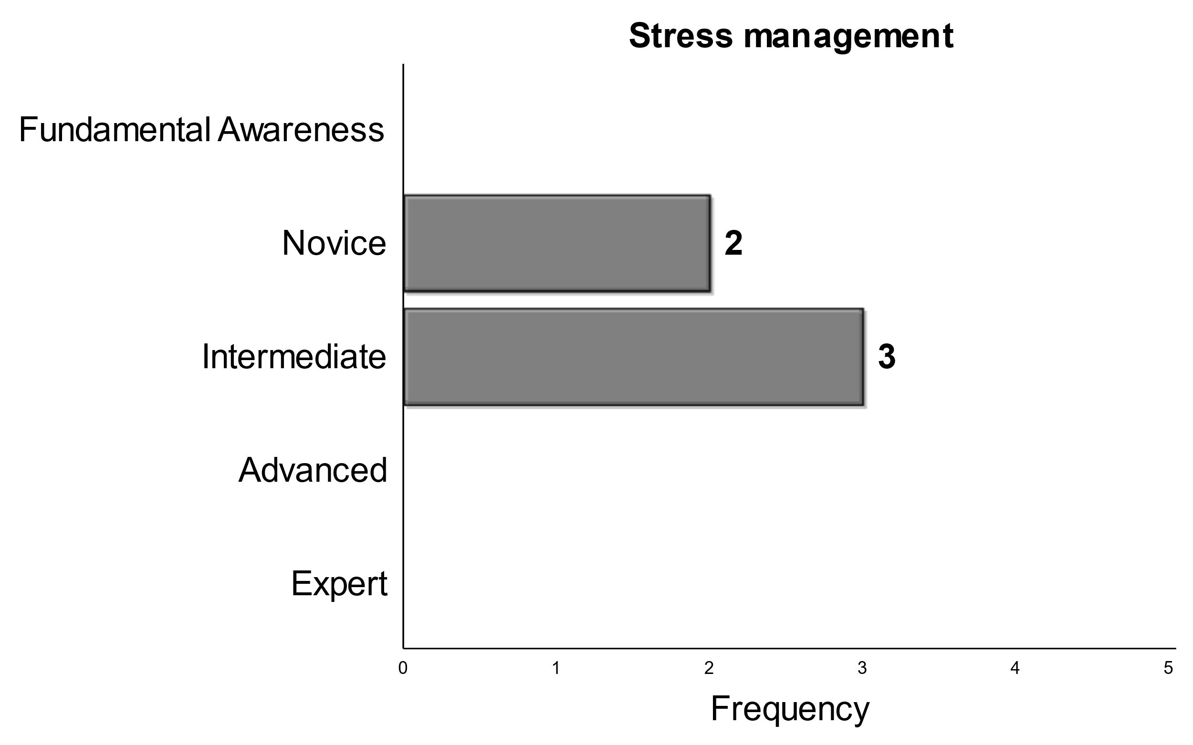
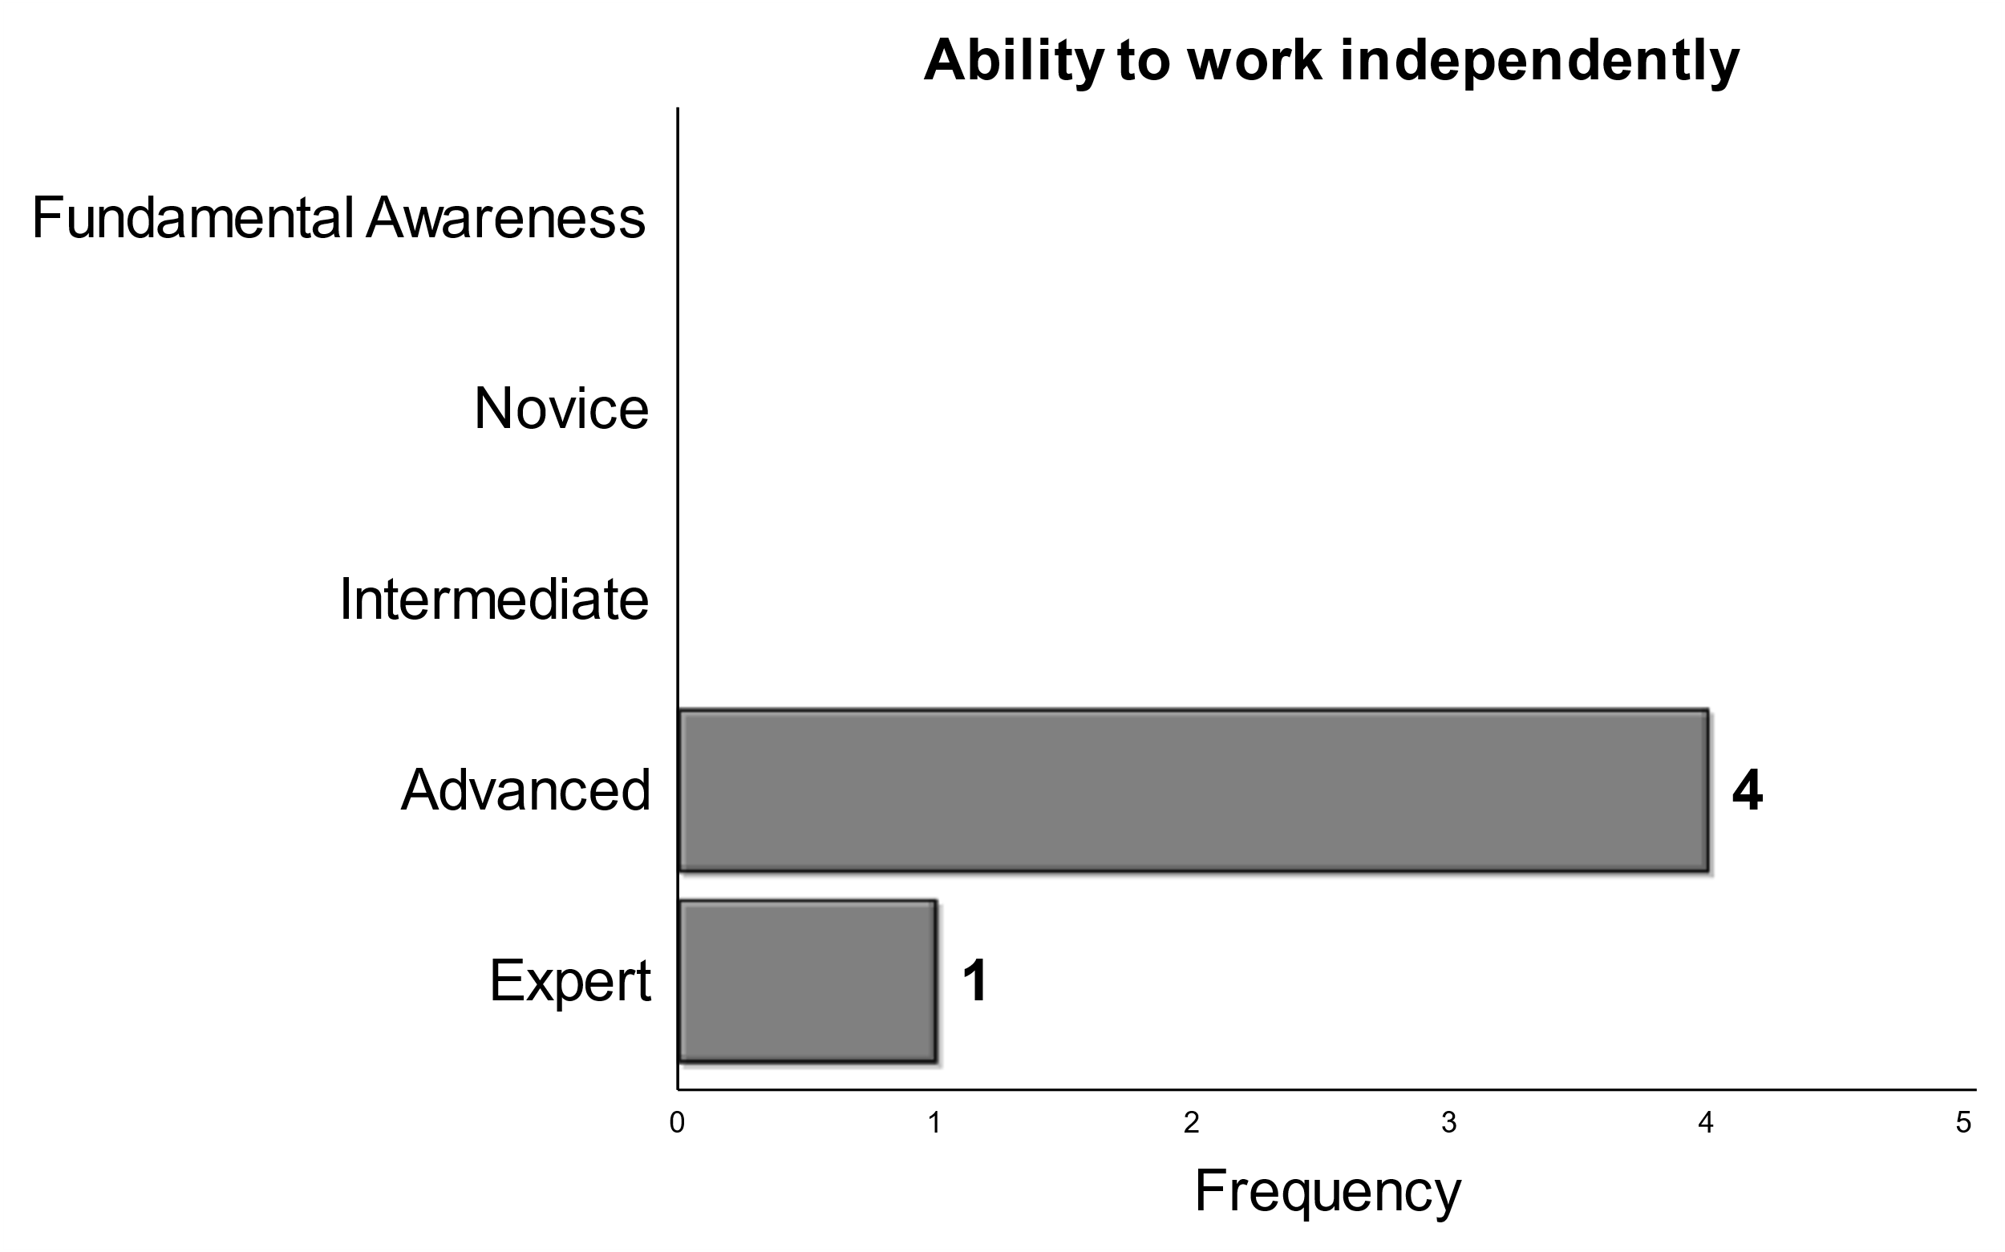
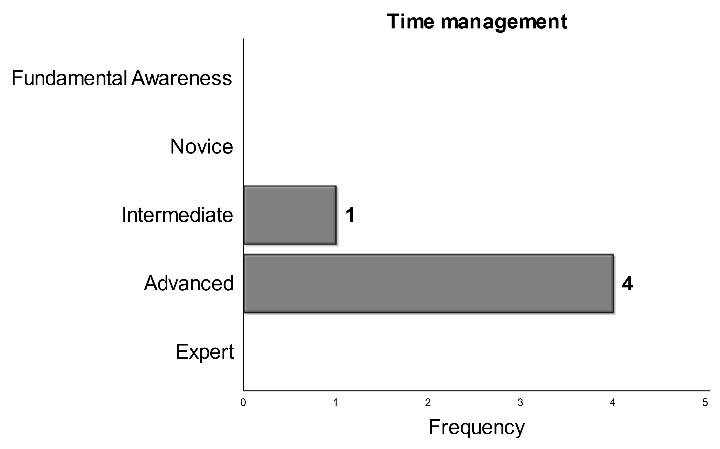
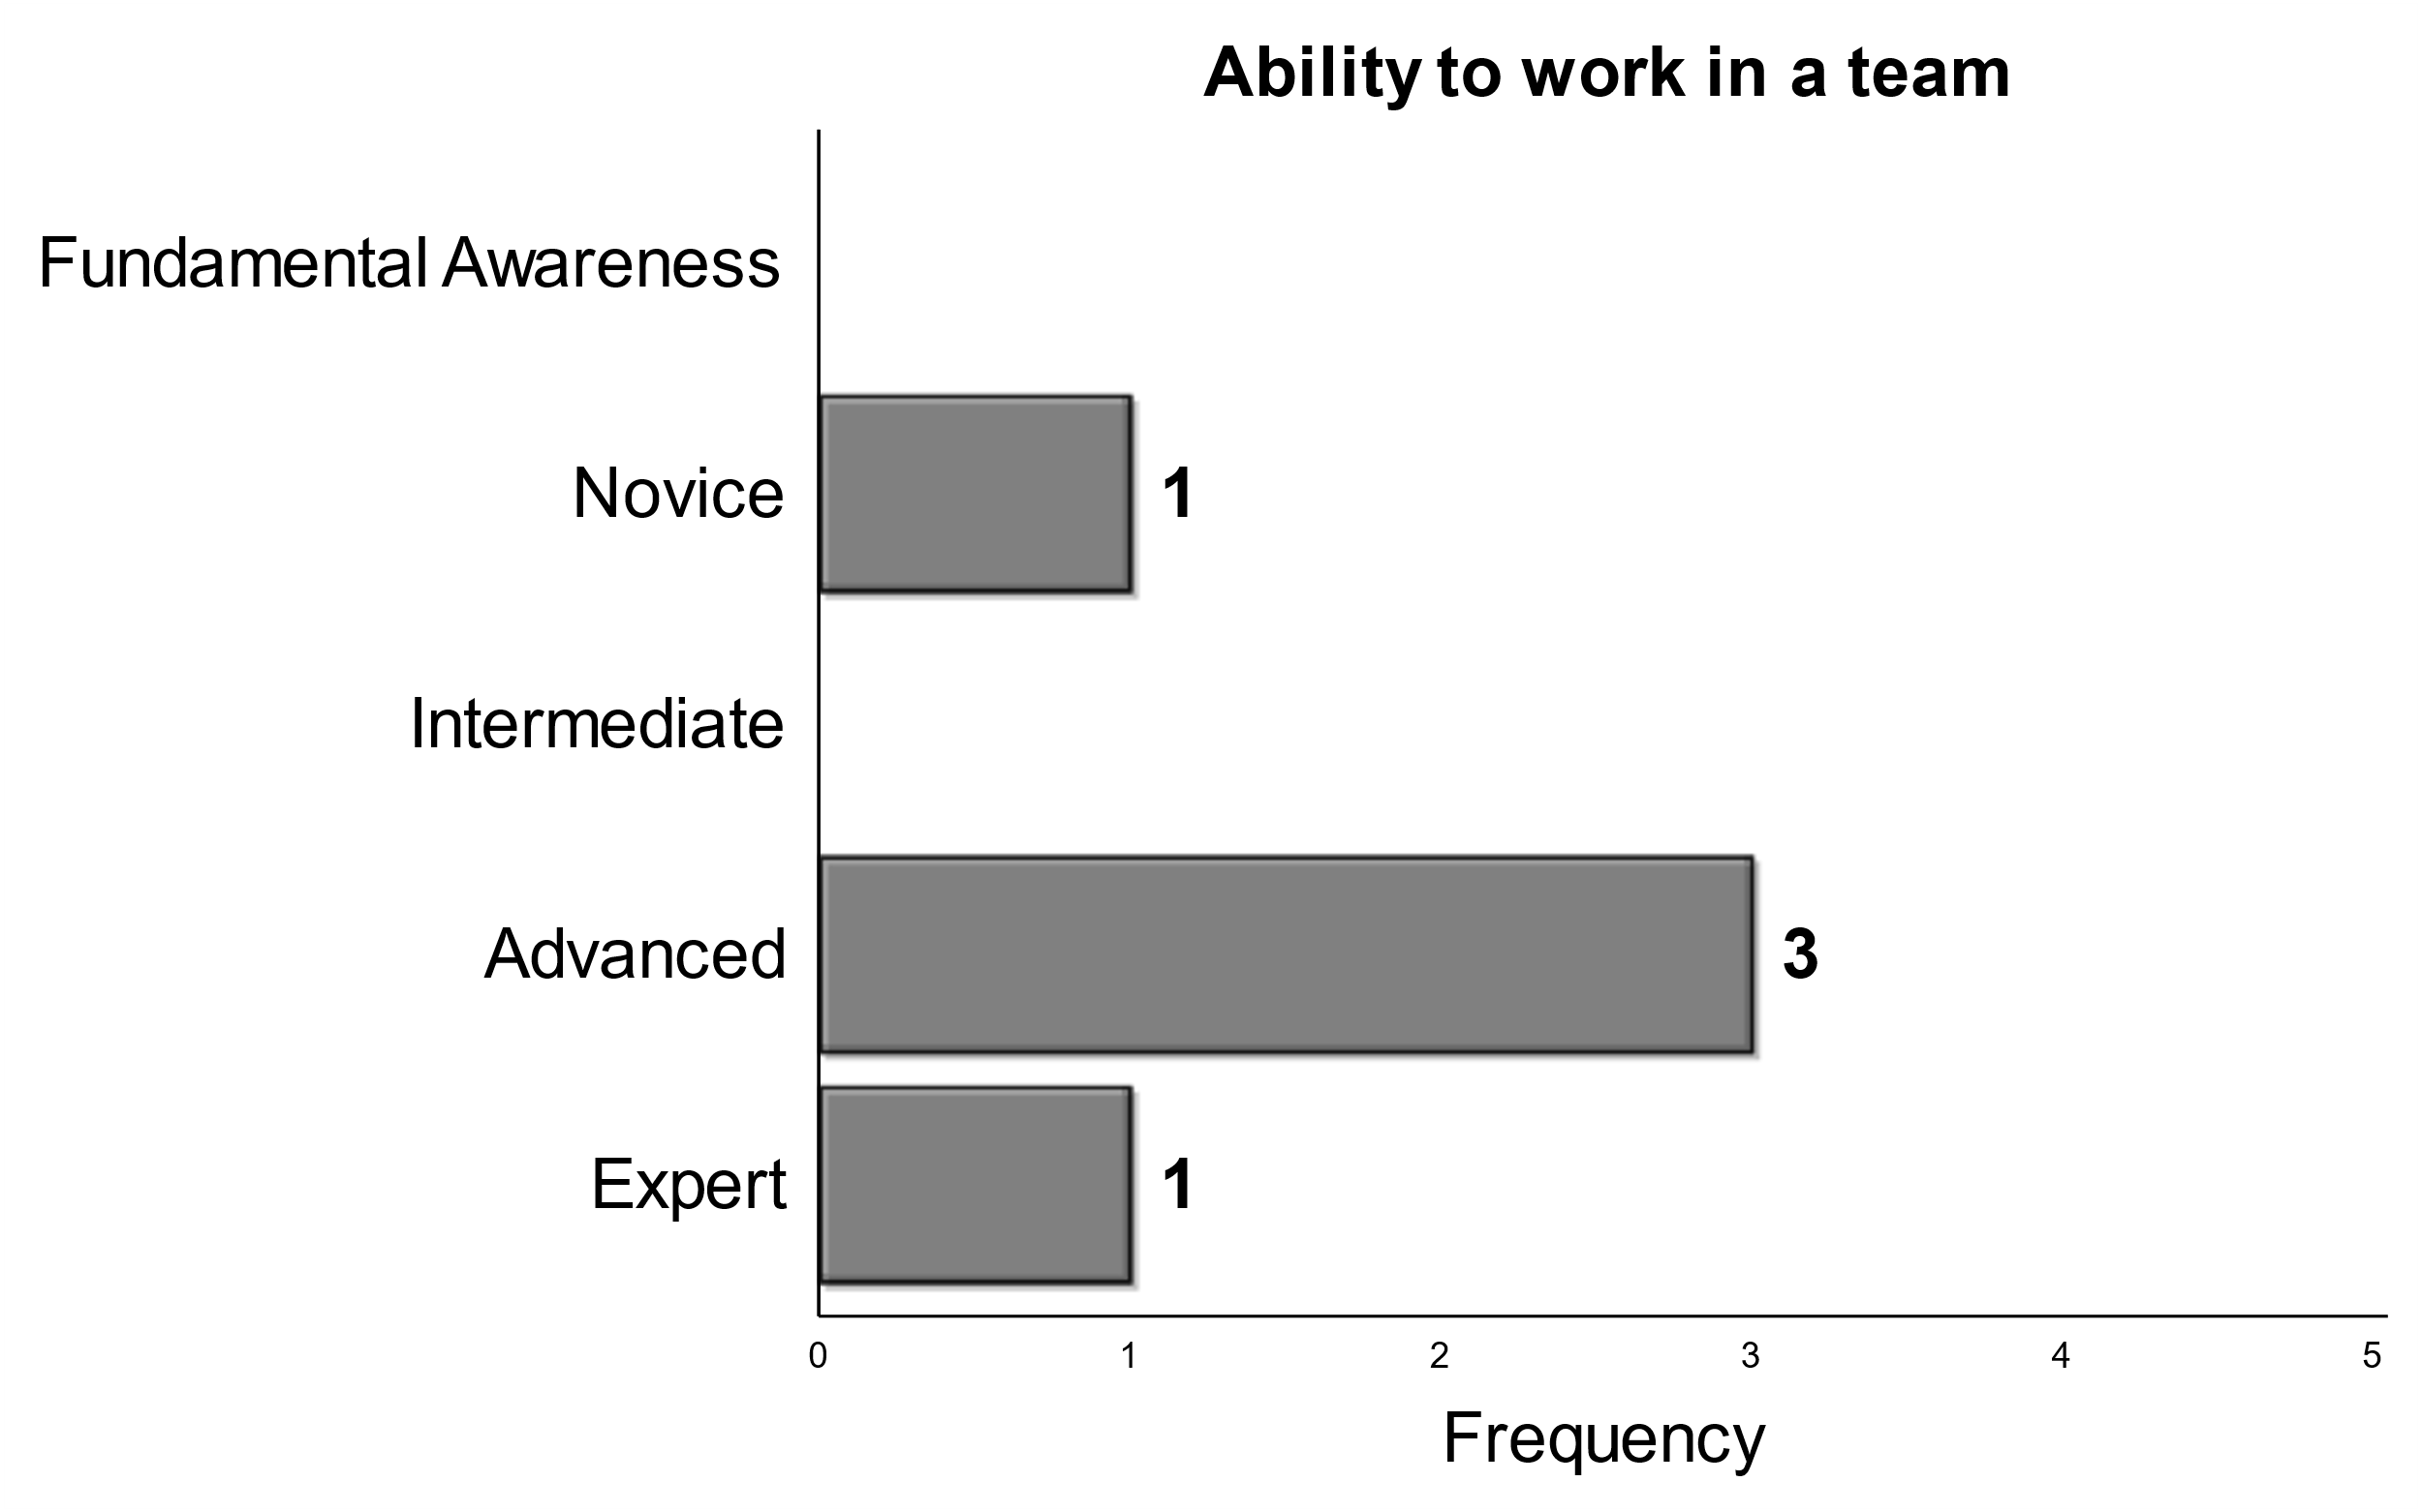
Working Styles

Slide 21



Teaching and Leadership
Notes:
Switching gears to teaching, leadership, and mentorship. Overall there is the expectation that students with Phds will have an intermediate skillset to advise/mentor as well as teach. The expectation is a bit higher overall for graduating phd’s leadership skills.

Slide 22





Other ‘Soft’ Skills

Slide 23
Discussion Questions

